Slide 1
2024-25 Budget Ambassadors Workshop
Part II - March 14, 2024

Slide 2
Welcome Ambassadors!
These meetings are intended to share information about the district’s finances
Please ask questions any time that one arises
Allow others to talk without interruption
Be respectful
Share your recommendations with the board
Ultimately, all decisions are made by the Board of Education

Slide 3
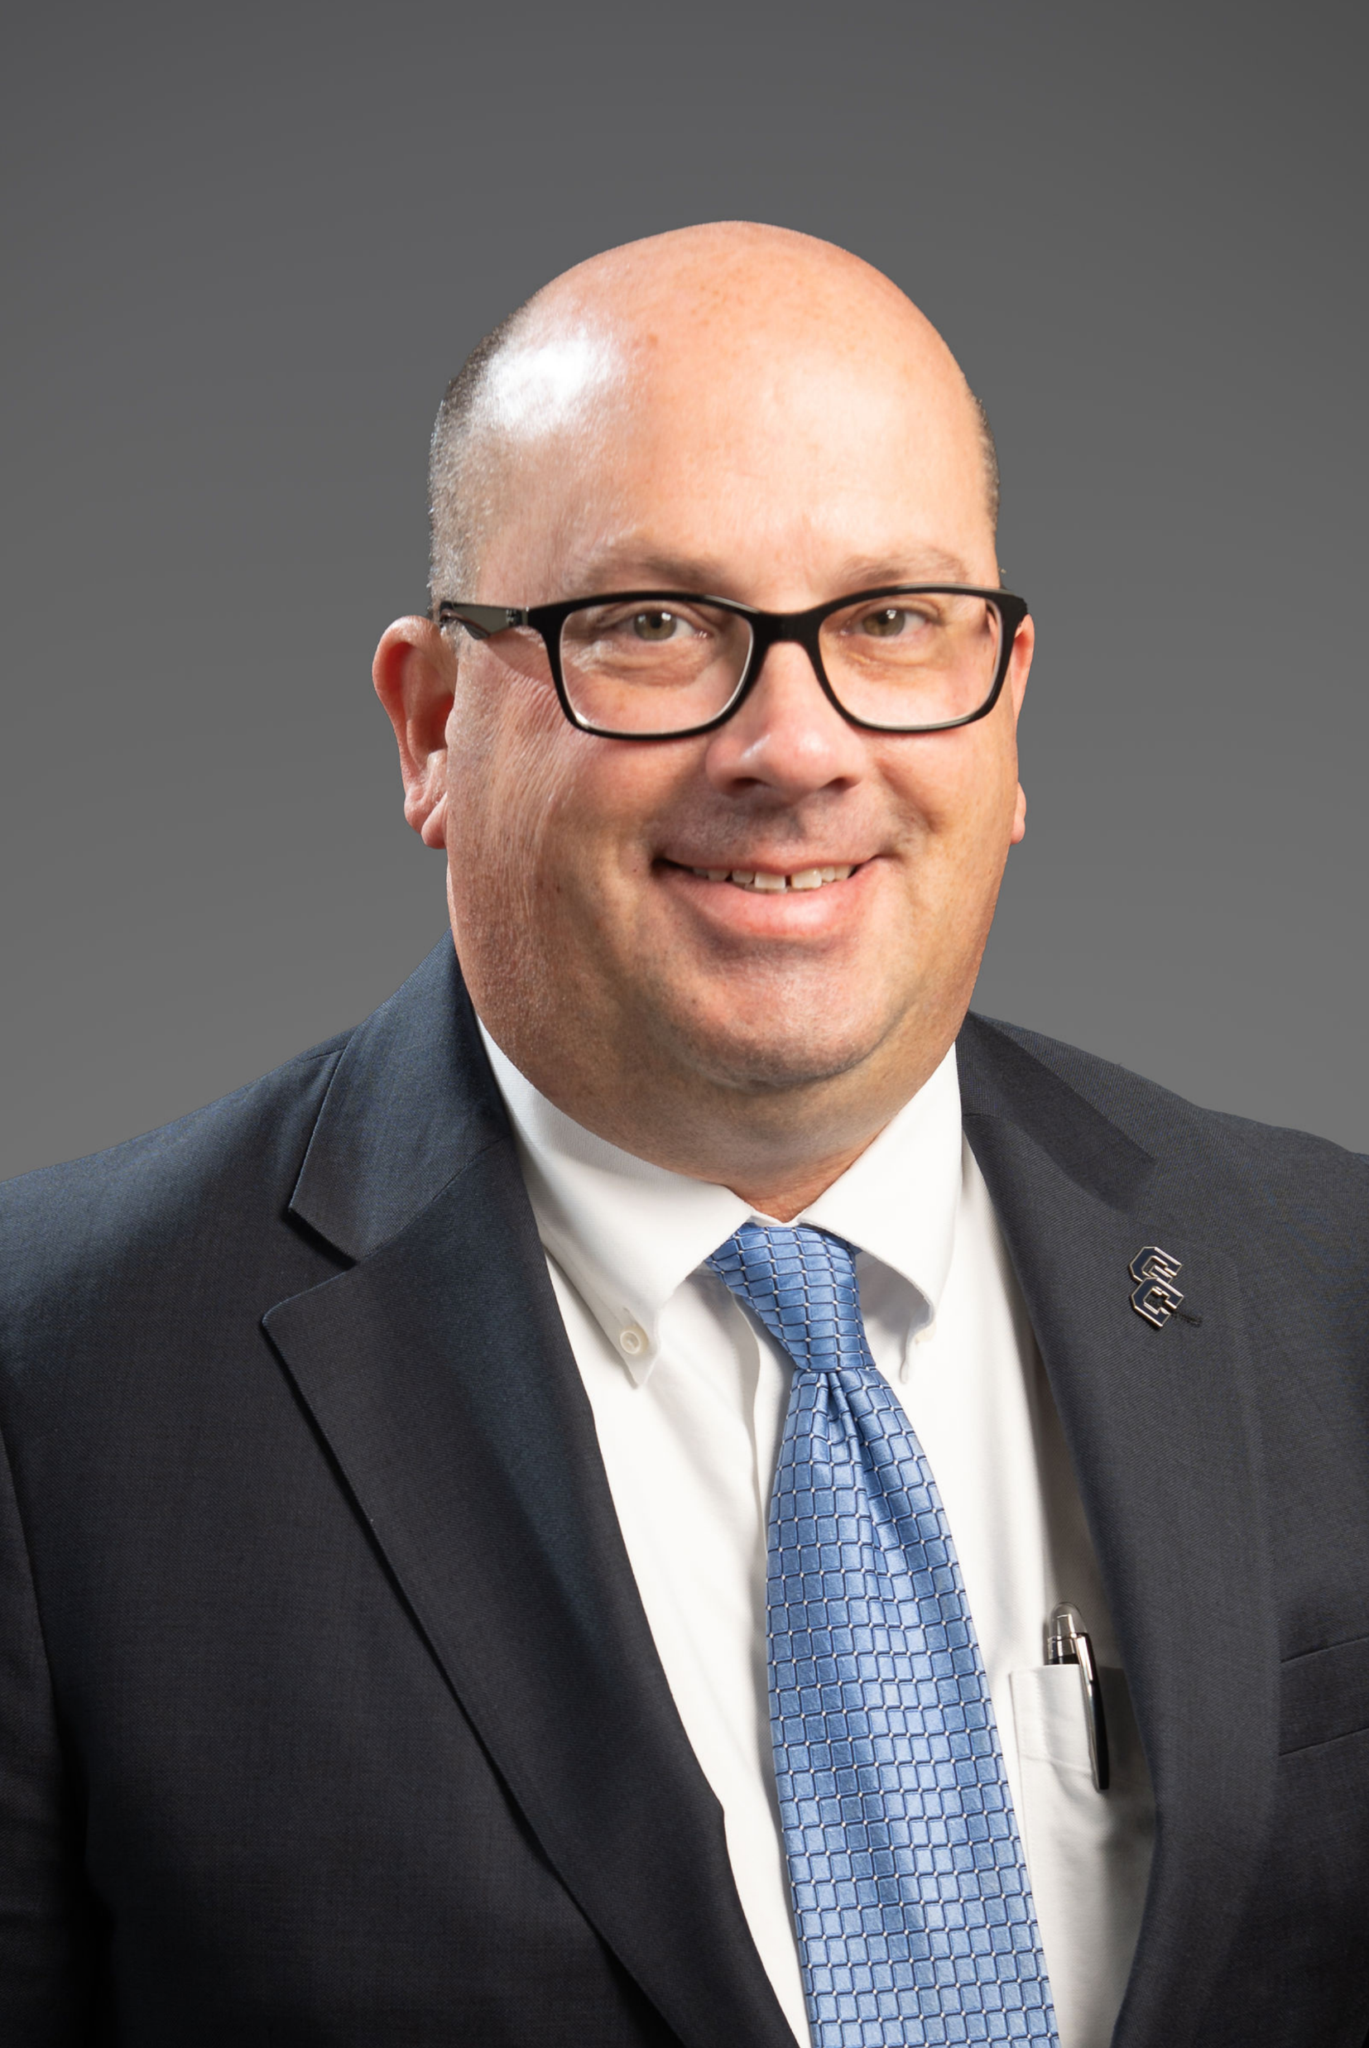
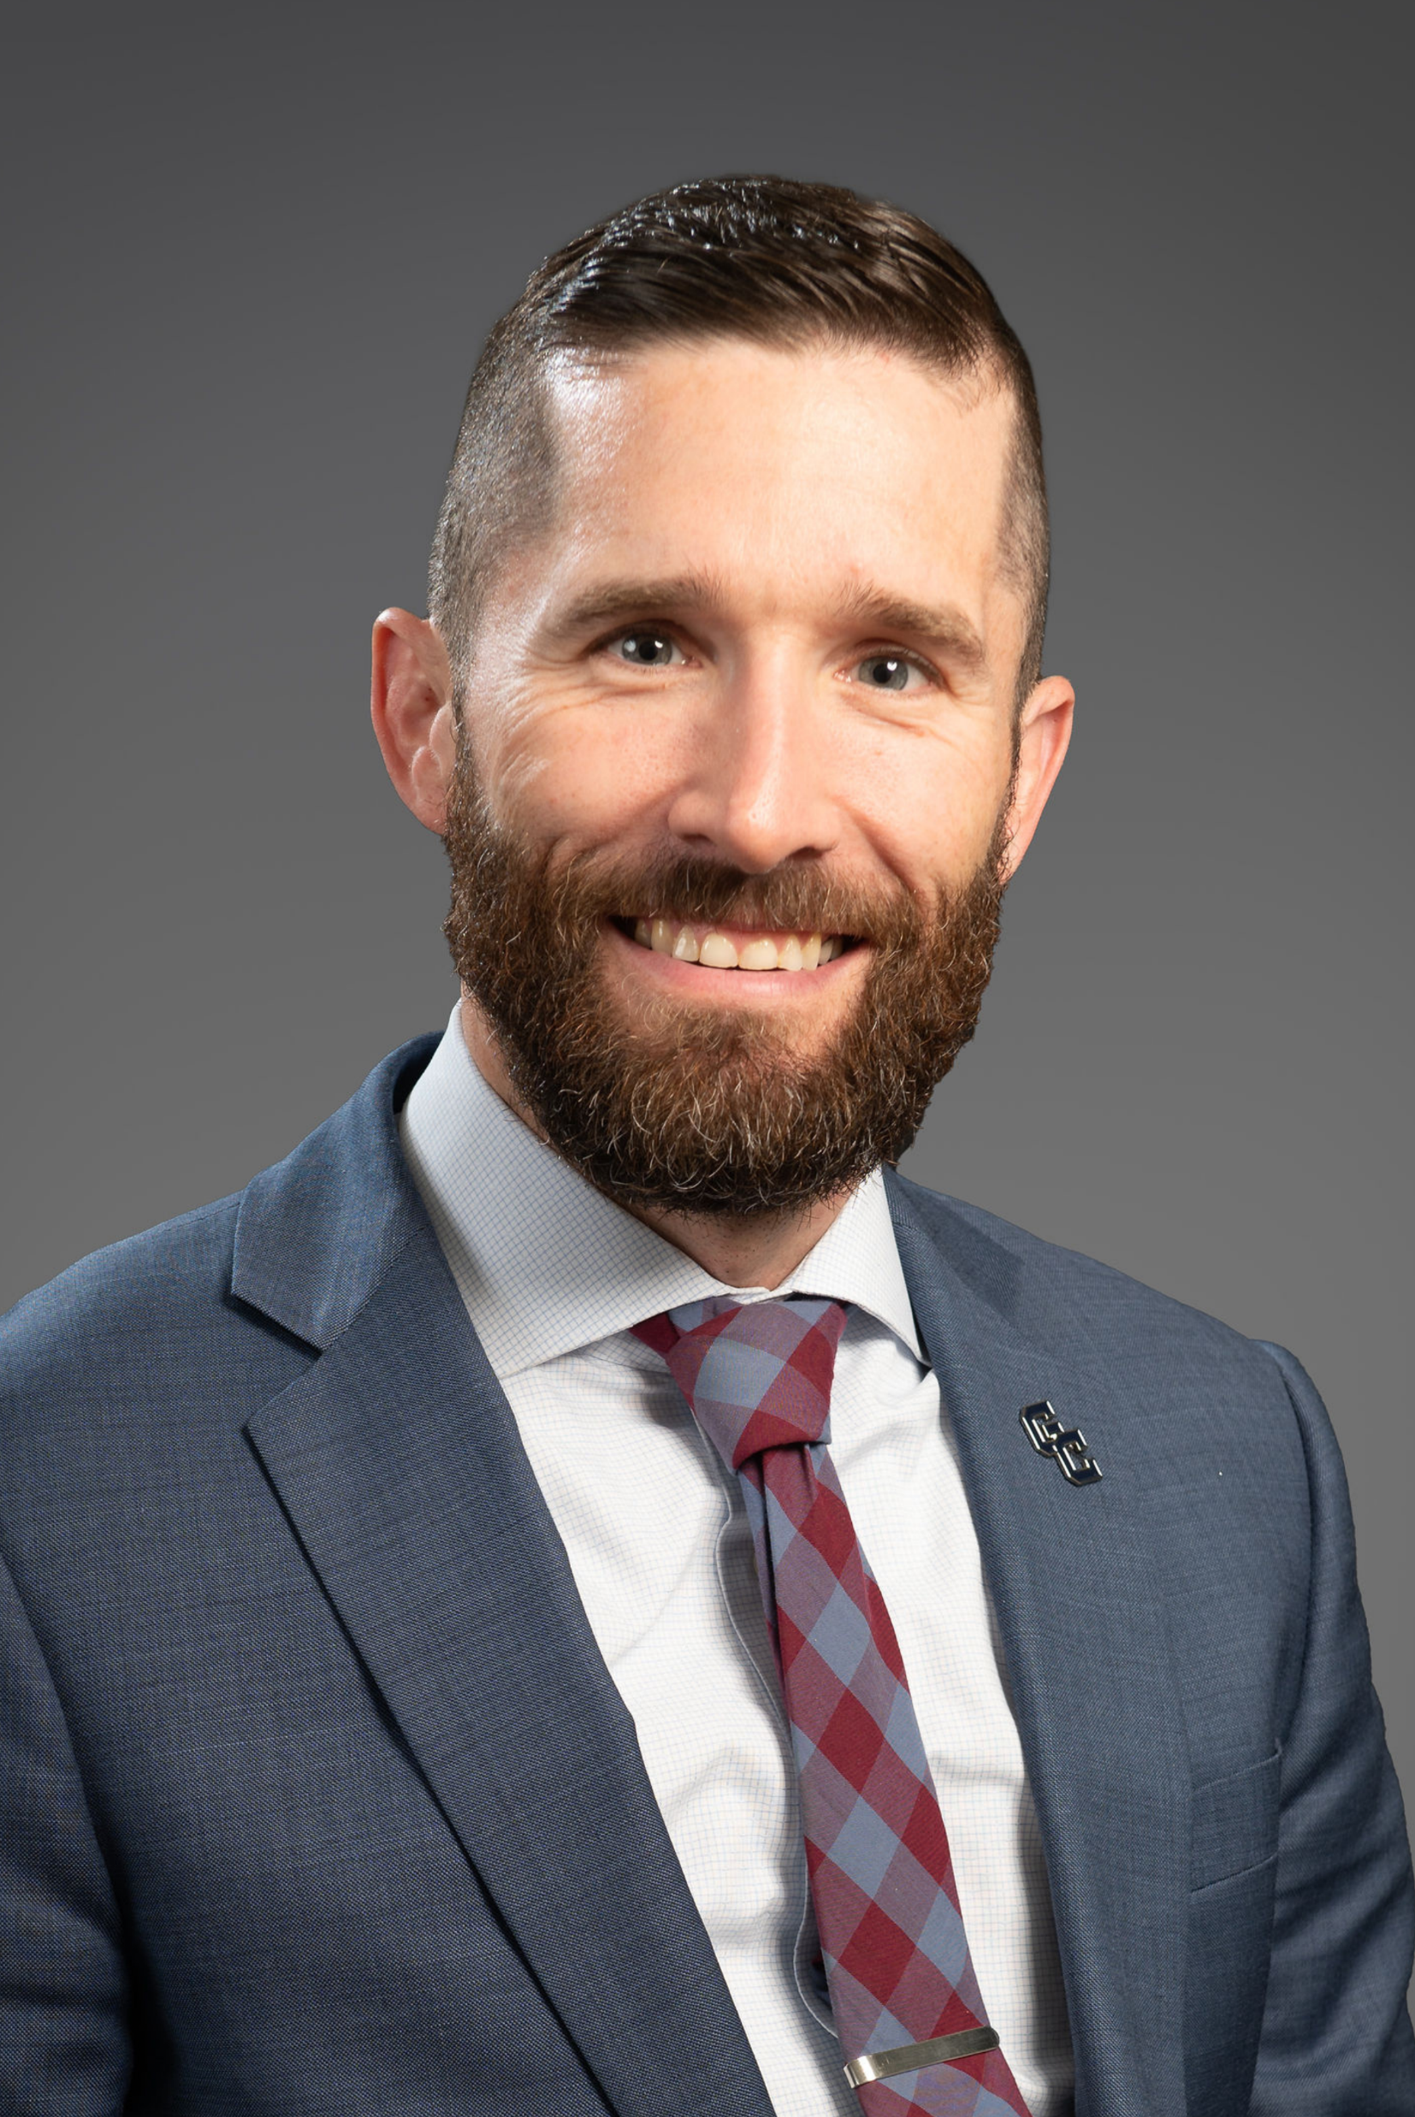
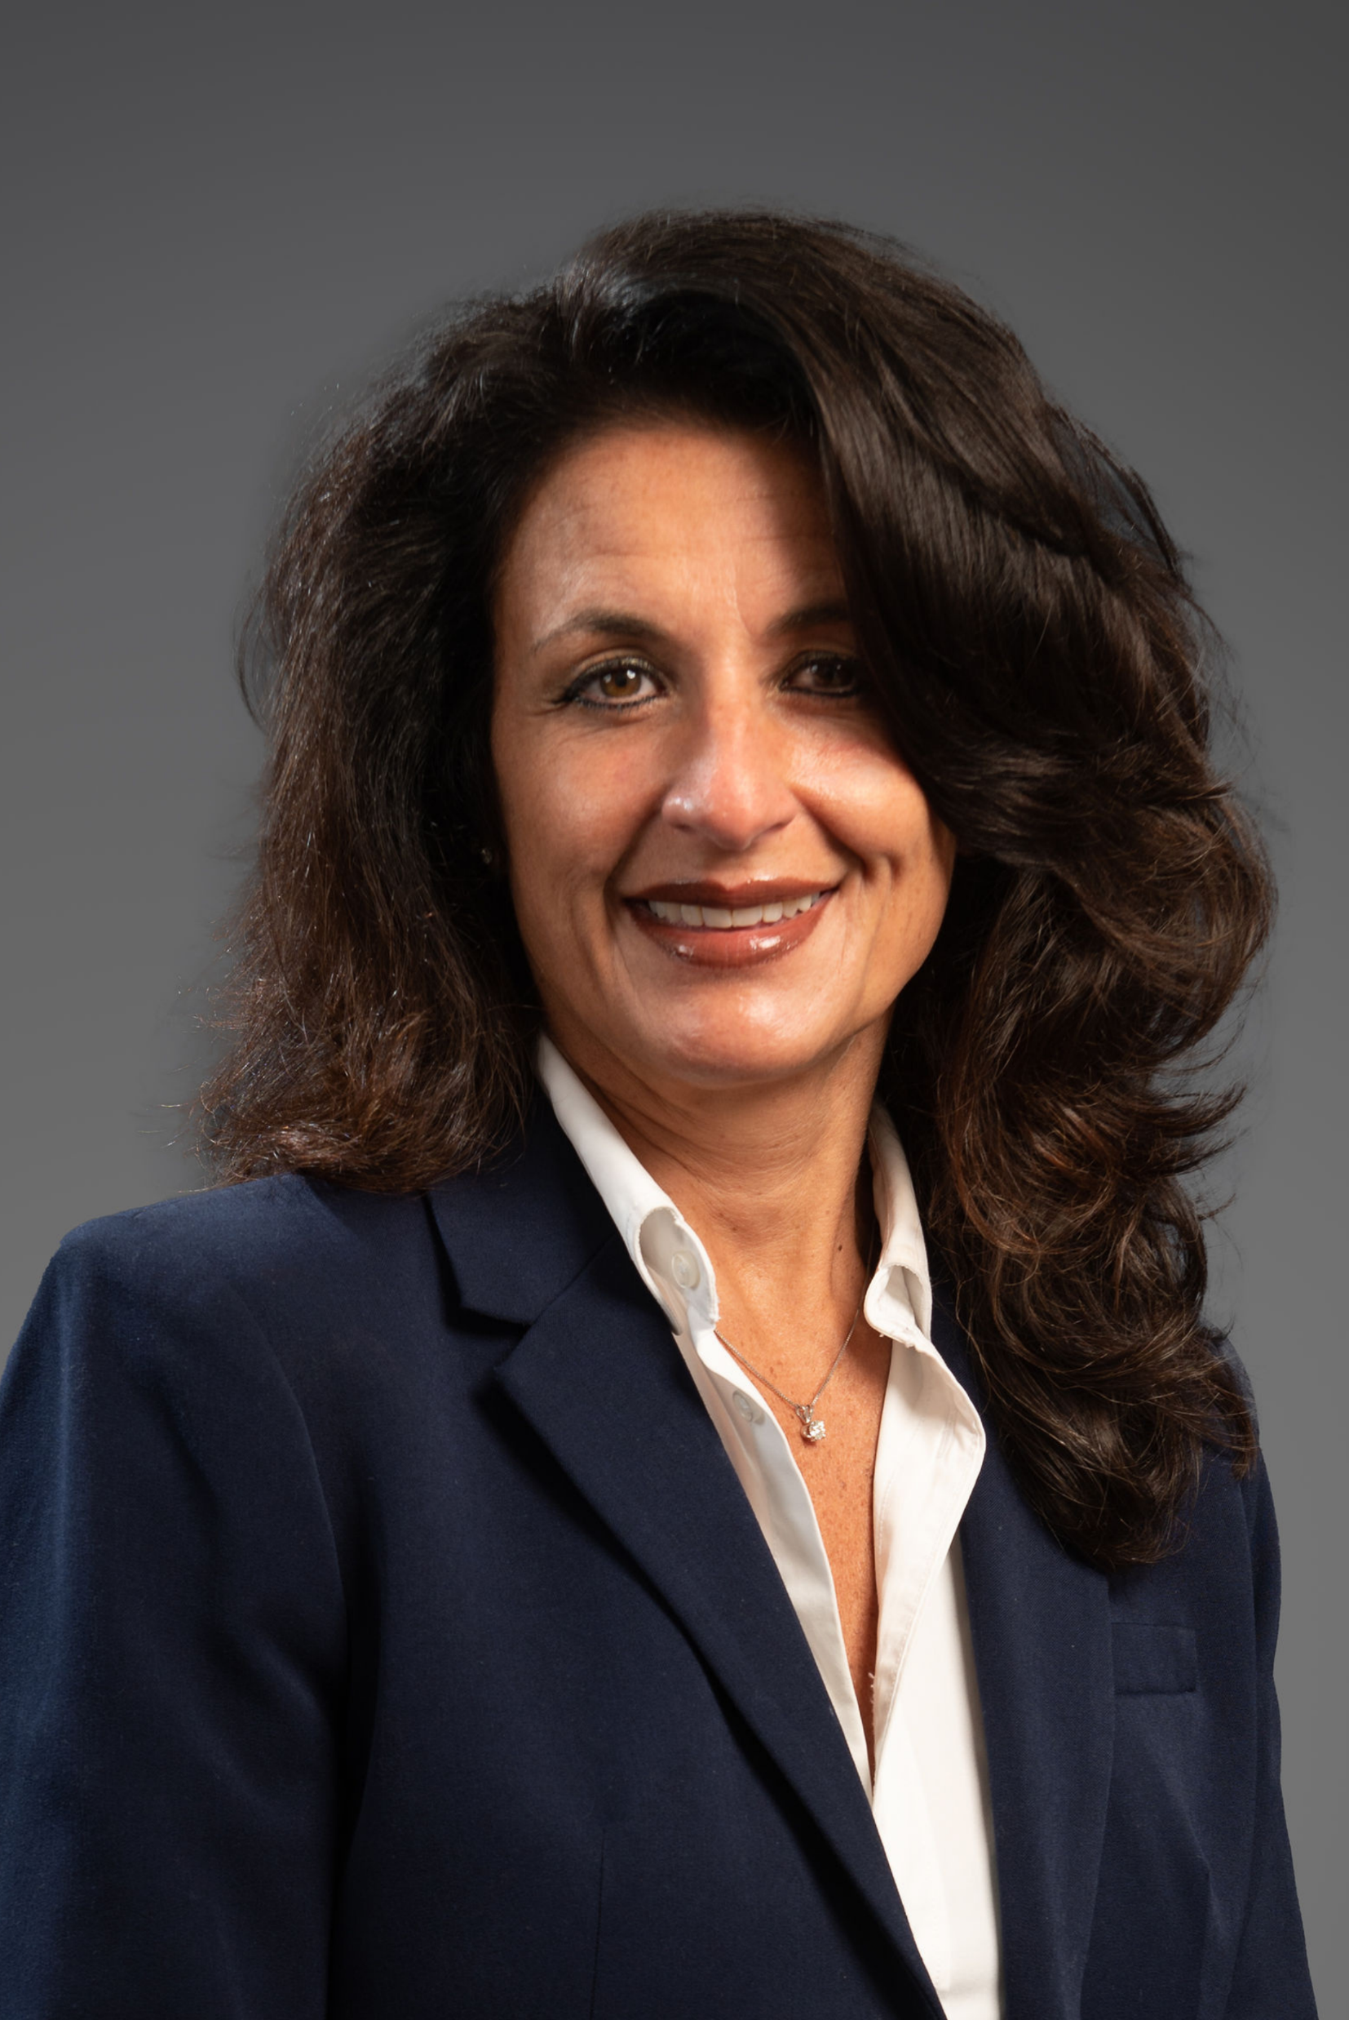
Introductions
Mr. Christopher Dailey Superintendent of Schools
Dr. Mitchell Ball Assistant Superintendent for Business
Ms. Sally Sanford
District Treasurer
Mrs. Anna Lamb Assistant School Business Administrator

Slide 4
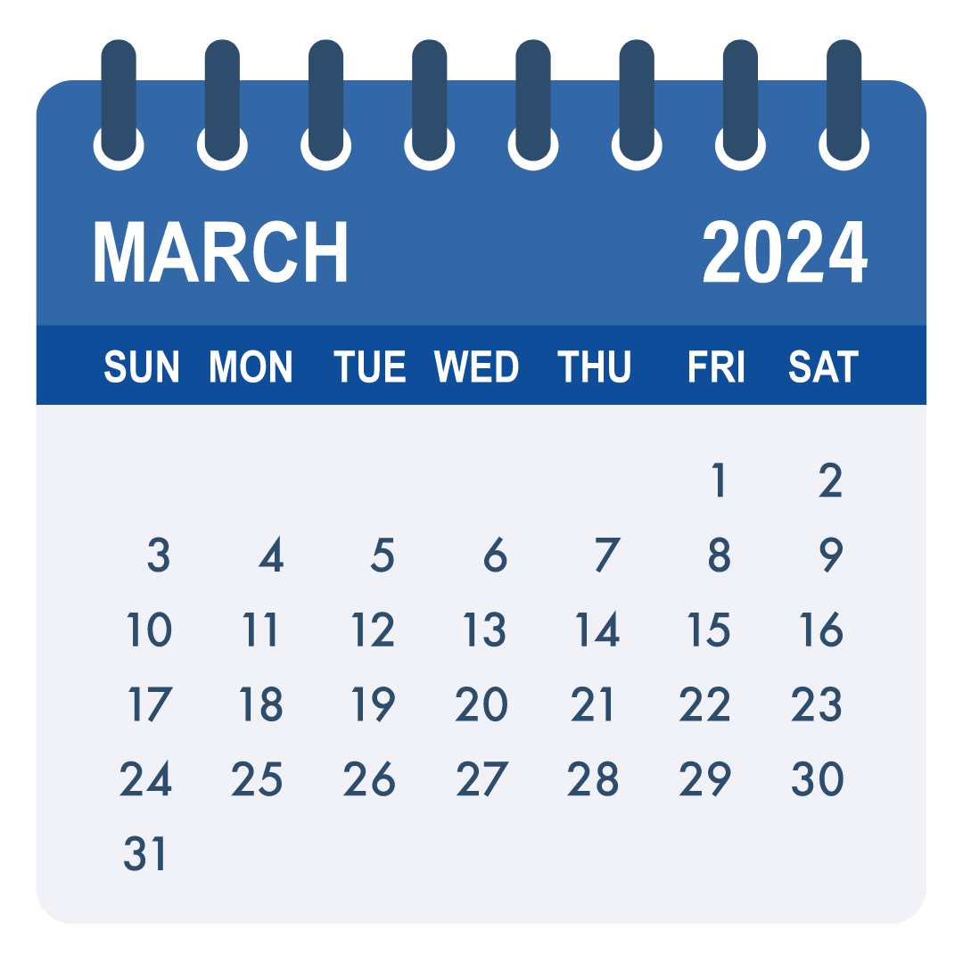
Budget Ambassador Schedule
March 7 at 6 p.m.
District Overview, Expenditures, Payroll, Benefits, Other Expense Categories
March 14 at 6 p.m.
Revenues, Tax Cap, Reserves, Financial Summary Charts, Budget Ambassador Survey

Slide 5
Tonight’s Agenda
Recap of expenditure session
Follow-up to last session
Revenues
Tax Cap
Reserves
Budget Ambassador Survey

Slide 6
Recap of Last Session March 7, 2024

Slide 7
District Snapshot
Students
Slight decrease in enrollment 3,573
Diverse Population
English Language Learners 5%
Students with Disabilities 13%
Economically Disadvantaged 54%
Employees
Active employees 1,259
Retired employees 732
Average years of service 9.97 years
Programs
Mental health support
Broad range of accelerated and Advanced Placement (AP) offerings
Many athletic and extracurricular activities
Free and Reduced Lunch
Career and Technical Education
Notes:
Strong representation across a broad spectrum of race and ethnicity
SES / FRPL: at 50%
ELL: Around 4-5%

Slide 8
Significant Expenditure Challenges
Benefit costs
$35+ Million
26.3%+ of Total Budget
Increase: Approx. $245,058
Transportation costs
Affected by gas / electric, power infrastructure and parts prices ​
Bus base price increase​
Special education placements ​
Special education costs
$19.4M - $20M
14.6%+ of Total Budget
Debt service for capital costs
$10.6M
8%+ of Total Budget
Notes:
Strong representation across a broad spectrum of race and ethnicity
SES / FRPL: at 50%
ELL: Around 4-5%

Slide 9
Follow-up Items

Slide 10
Follow-up from our last session
Different Funds
A Fund General
C Fund School Lunch
CM Fund Miscellaneous Special Rev
F Fund Special Aid (Federal)
H Fund Capital
K Fund Fixed Assets
V Fund Debt Service
Notes:
Funds established by NYS Comptroller. Funds besides A General Fund allow for multi-year accounting versus close out each fiscal cycle (July to June).

Slide 11
Follow-up from our last session
How long does a teacher stay with the district?
Total number of teachers: 456
Avg. years of service 13.03
Avg. years of GC service at retirement 20.67
Avg. years of service in education 22.71
Intro to Education Program
Second year
13 participants

Slide 12
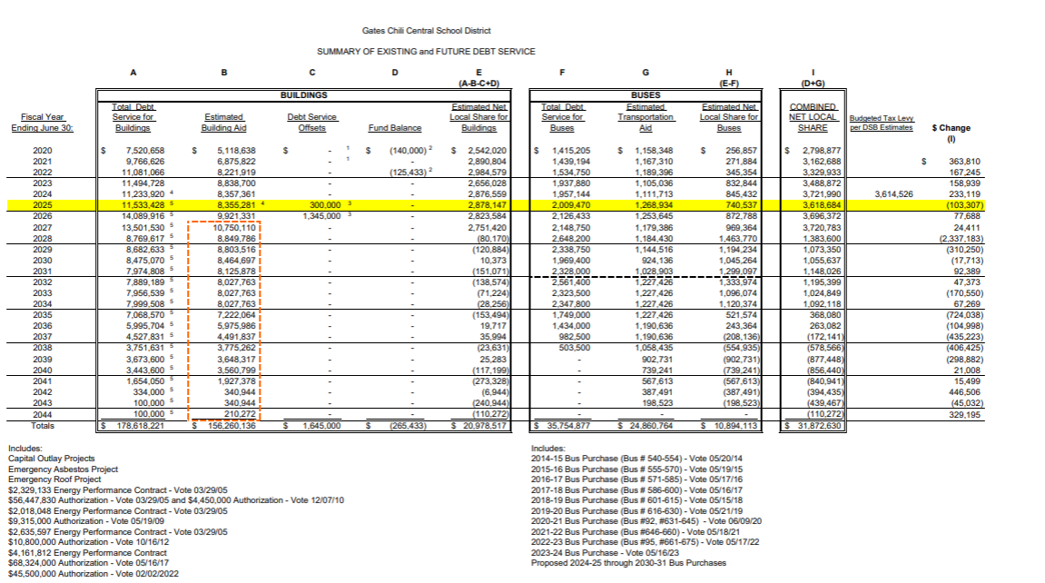
Follow-up from our last session
Debt Service Schedule: Handout

Slide 13
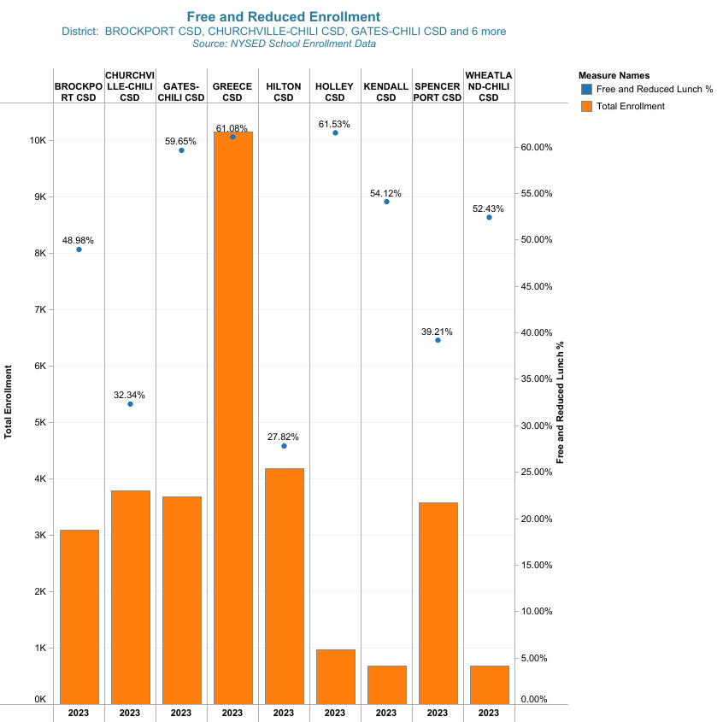
GC Free and Reduced vs. Peers
Notes:
Answer to how we compare with peers in terms of FRLP

Slide 14
Predicting Revenues

Slide 15
Preliminary Revenue Budget
$ 133,061,110
3.5% - Estimated increase from 2023-24
$ 4,508,695 - Estimated increase
Important Note:
CPI-U: 4.12% State Aid and Reserve Use still TBD
Notes:
Foundation Aid increased

Slide 16
Predicting Revenues
Four (4) largest revenue sources:
Local property taxes
State Aid
Reserves
Monroe County sales tax
Other revenue sources:
Tuition
Student Fees
Property / Equipment Rental
Medicaid Reimbursement
Interest earnings
Payments in-lieu of taxes
Admissions
Notes:
Removed Appropriated Funds

Slide 17
Limited Options
Investments for interest earnings
Focus on security and liquidity first, then interest earnings
Corporate Sponsorships
Few ties to private interest
We don't sell a product!
Notes:
Foundation Aid increased

Slide 18
Revenues Where does the money come from?

Slide 19
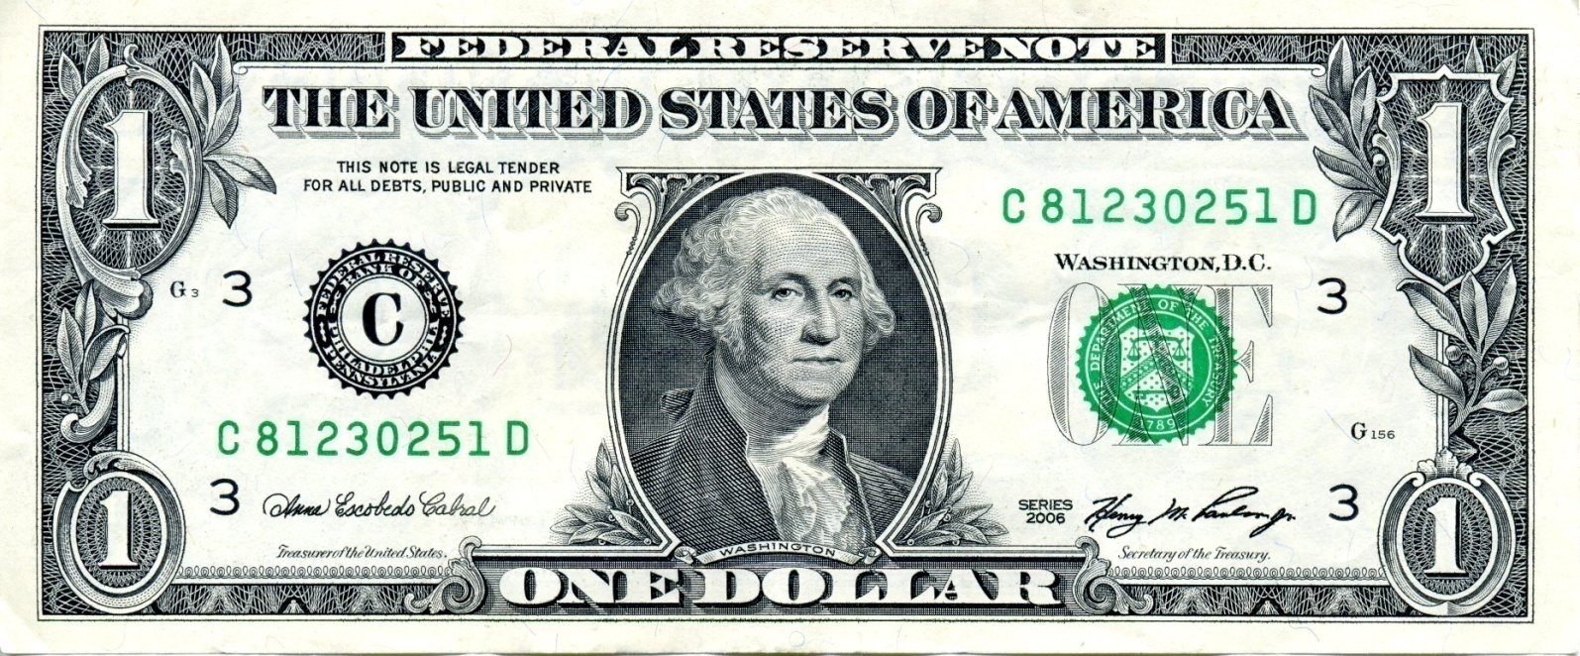
Current Year (23-24): Revenue Budget Breakdown
School Property Taxes 47¢
NY State Aid 43¢
Monroe County Sales Tax 3¢
Fund Balance and Reserves 3¢
Other Revenues 4¢
Interest earnings, payments in-lieu of taxes, Medicaid, fees, tuition
Notes:
We are not a business

Slide 20
Budgeting for State Funding (a.k.a. State Aid)

Slide 21
State Aid Timeline
State Budget runs April 1 through March 31
End of January The Executive Branch of New York State (Governor’s Office under the guidance of the Division of Budget) releases their proposal for funding operations.; part of that is the aid package for schools
March Negotiations between the Executive Branch (Governor) and the Legislative Branch (Senate Majority Leader and Assembly Speaker) occur
April 1 State budget due; an aid package is released and distributed to schools based on formulas and prior year(s) expenses
Notes:
Senate Majority Leader: Andrea Stewart-Cousins
Assembly Speaker: Carl Hastie

Slide 22
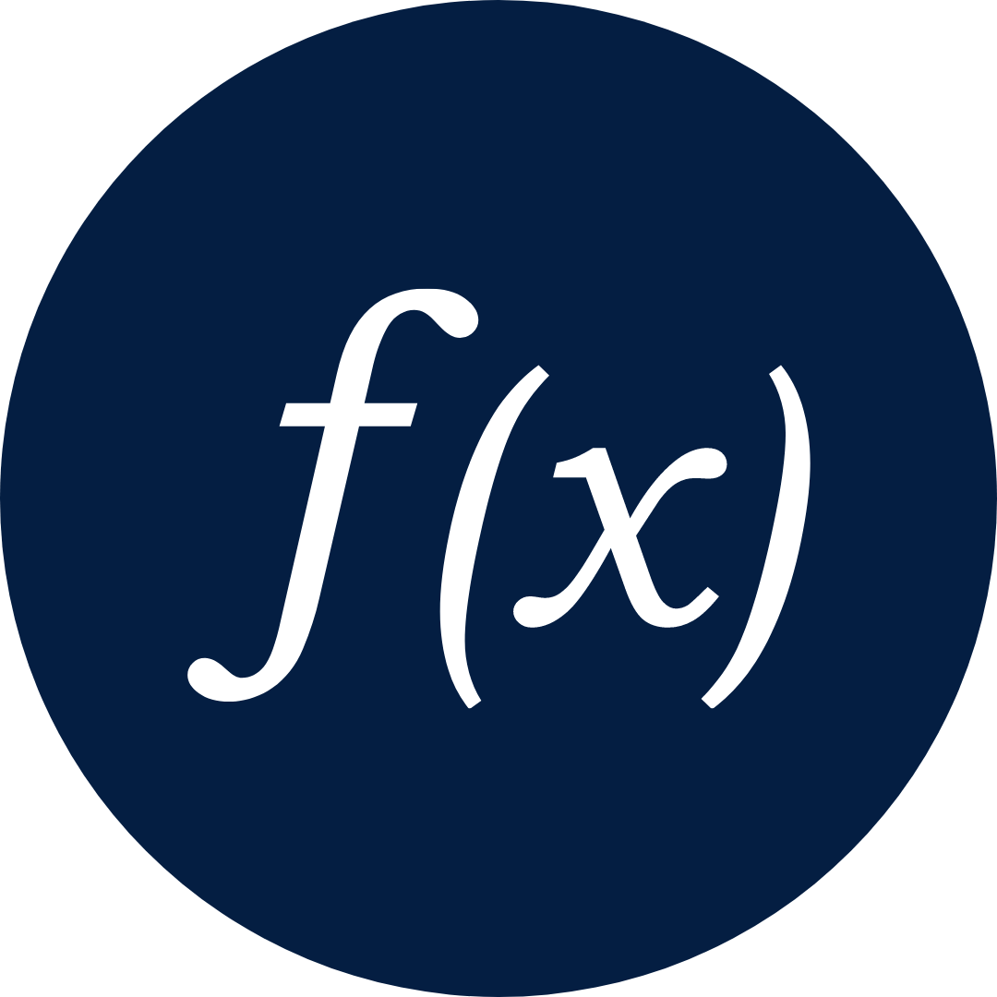
Two Main Types of State Aid
Formula-Driven Aid
Expense-Driven Aid
Notes:
NOTE: Share the state aid budgeting booklet… executive proposal
State funding in another major revenue source for the Gates Chili Central School District, accounting for over 37 percent of the revenue budget.
There are really 2 types of state aid.
formula driven aid, like foundation aid. This type of aid is distributed amongst the nearly 700 districts statewide using complex formulas that look at data sets like demographics, student counts, poverty indicators, local wealth measures, and community composition. The state simply plugs local data sets into the formulas to generate our share of funding out of the general state budget allocation of education funding.
Categorical or expense-based aid. These types of aid are distributed specifically based on our expenses. For instance, when we buy buses, we get approximately 75 cents on the dollar back from the state, in the following year.
Majority of the increase in state aid is tied directly to prior year or years expenditures. We are getting money back on expenditures that have already occurred.

Slide 23
Formula-Driven Aid
Distributed amongst the nearly 700 districts statewide
Uses complex formulas that look at data sets like:
Demographics
Student Counts
Poverty Indicators
Local Wealth Measures
Community Composition
The state plugs local data sets into the formulas to generate district funding out of the general state budget allocation of education funding.

Slide 24
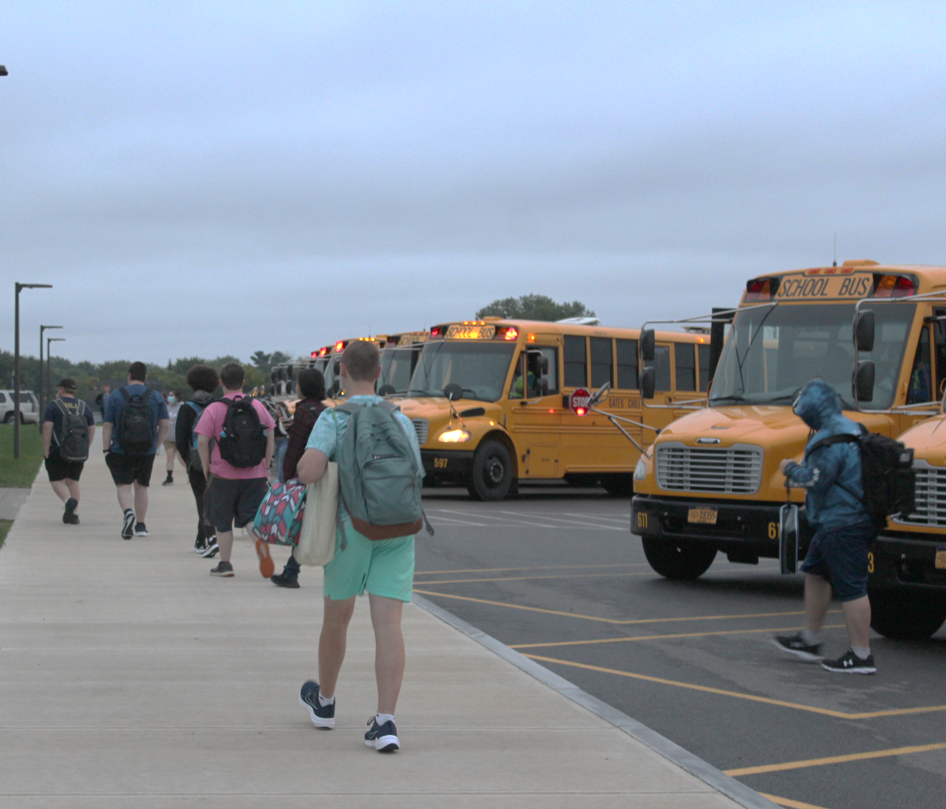
Expense-Driven Aid (Categorical)
Distributed based explicitly on our expenses.
Example: district purchase of buses (we get approx. 75 cents on the dollar back from the state in the following year)
Major State Aid increases are based directly on prior year or year expenditures.
Reimbursement on expenditures that have already occurred.

Slide 25
Gates Chili State Aid Factors
Selected Formula-Driven Aid Factors:
0.658 Combined Wealth Ratio
0.597 Free and Reduced Lunch %
Selected Expense-Driven Aid Factors:
0.713 BOCES Aid Ratio
0.665 Public Excess Cost Aid Ratio
0.902 Private Excess Cost Aid Ratio
0.751 Transportation Aid Ratio
0.813 Building Aid Ratio
Notes:
From Questar – State Aid Factors for the current year
https://www.questar.org/services/financial/state-aid-financial-planning/resources/
Do not use the state output report

Slide 26
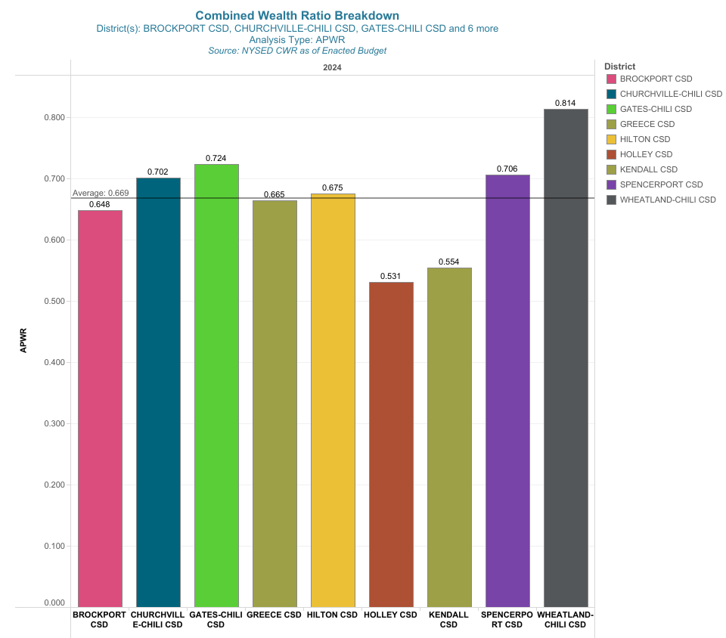
Combined Wealth Ratio – Regional Comparison
Key Takeaway:
Although Gates Chili is below the statewide average for CWR, regionally, we are on the high end. This means we get a smaller portion of state aid and are more reliant on our tax base to balance our budget.
Notes:
Income Wealth: 0.757
Property Wealth: 0.698

Slide 27
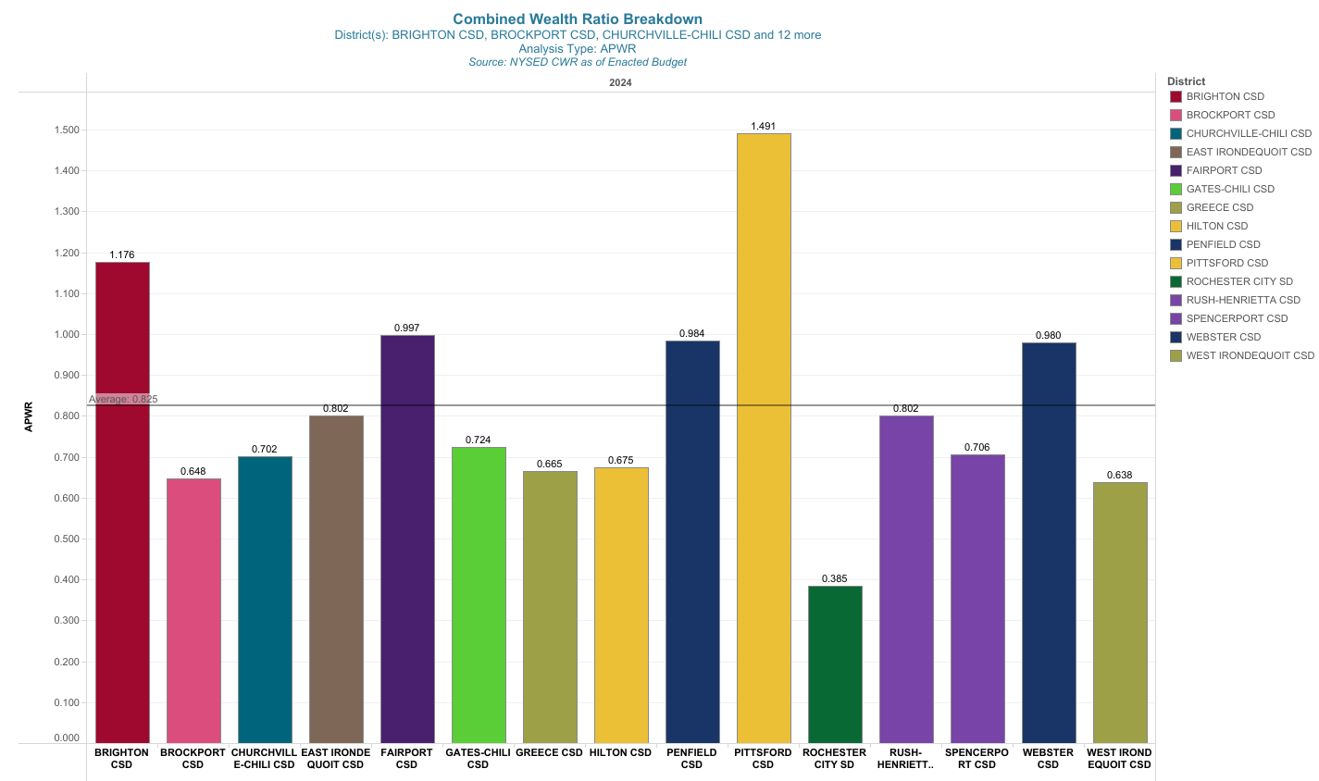
Combined Wealth Ratio – Monroe County Comparison
Key Takeaway:
For Monroe County, we are near average for CWR, below most of the eastside districts.

Slide 28
Current Year: State Funding
State Aid estimate accounts for:
43% of General Fund Revenue
Current Estimate: $55,351,646
Notes:
State funding in another major revenue source for the Gates Chili Central School District, accounting for over 37 percent of the revenue budget.
There are really 2 types of state aid.
formula driven aid, like foundation aid. This type of aid is distributed amongst the nearly 700 districts statewide using complex formulas that look at data sets like demographics, student counts, poverty indicators, local wealth measures, and community composition. The state simply plugs local data sets into the formulas to generate our share of funding out of the general state budget allocation of education funding.
Categorical or expense-based aid. These types of aid are distributed specifically based on our expenses. For instance, when we buy buses, we get approximately 75 cents on the dollar back from the state, in the following year.
Majority of the increase in state aid is tied directly to prior year or years expenditures. We are getting money back on expenditures that have already occurred.

Slide 29
2024-2025 NYS Executive Budget
Proposal recommends:
$35.3 Billion for School Aid
Increase of 2.39% over the 2023-24 SY of $34.5 Billion
Notes:
Governor Hochul Announces
proposing a total of $35,306.34 million in state support for public schools
made up of: $34,751.45 million in formula-based aids
$554.89 million in categorical aids and grant programs
2.39% increase over the 2023-24 State Budget for school aid
https://www.questar.org/wp-content/uploads/2024/01/Executive-Proposal.pdf

Slide 30
Executive Proposal Includes…
Incentivize qualifying public and nonpublic schools with significant proportions of low-income students to participate in the federal Community Eligibility Provision (CEP) program by subsidizing any remaining local share of costs of all schools participating in such program, allowing all students in such schools to eat breakfast and lunch at no charge regardless of their family’s income.
Reduce all school districts currently on “Save Harmless”
Notes:
https://www.questar.org/wp-content/uploads/2024/01/Executive-Proposal.pdf
Foundation Aid – $24,505.96 billion ($507.08 million increase). 2024-25 Foundation Aid = the sum of the Transition Adjustment plus the product of total aidable foundation aid pupil units (TAFPU) multiplied by the district’s Selected Foundation Aid The Transition Adjustment is equal to the product of (a) the State Sharing Ratio for Total Foundation Aid for the 2024-25 school year, but not less than 50 percent, multiplied by (b) 2023-24 Foundation Aid less the Total Foundation Aid. 2024-25 Foundation Aid is inclusive of the Community Schools set-aside.
Expense Driven Aids – No formula aid changes proposed for any of the following aids:
• Building Aid/Reorganization Incentive Building Aid – $3,349.01 million ($48.01 million decrease)
• Transportation Aid Including Summer Transportation Aid – $2,543.46 million ($148.45 million increase)
Interaction with Environmental Bond Act: The 2024-25 Executive Budget amends the calculation of Transportation Aid to exclude any grants (or vouchers on behalf of a district) provided through the Clean Water, Clean Air and Green Jobs Environmental Bond Act of 2022 from being considered revenue that would otherwise reduce a district’s allowable transportation expense. School districts that receive these grants (or vouchers) to purchase zero-emission buses would thus receive more Transportation Aid than under current law; however, the sum of Transportation Aid and the Bond Act funding could not exceed the expenses.
• BOCES Aid – $1,275.26 million ($17.93 million increase)
• Software, Textbook & Library Materials Aids – $220.85 million ($.38 million increase)
• Computer Hardware and Technology Aid – $34.26 million ($0.46 million increase)
• Supplemental Public Excess Cost Aid – $4.31 million ($0 change)
• Special Services Aid – $223.99 million ($2.23 million increase)
• Academic Enhancement Aid – $9.57 million ($0 change)
• High Tax Aid – $223.30 million ($0 change)
• Charter School Transitional Aid – $58.13 million ($5.00 million increase)
• Public High-Cost Excess Cost Aid – $649.81 million ($75.06 million increase)
• Private Excess Cost Aid – $455.55 million ($17.44 million increase). Reorganization Incentive Operating Aid – $2.37 million ($0.66 million decrease).
• Universal Prekindergarten Aid – $1,176.94 million ($99.35 million increase).
• Summer School Special Education (§4408) – $404.0 million ($36.50 million increase).
• Lunch/Breakfast Programs – A total of $180.00 million in State funds is available to subsidize school lunch and breakfast programs.
o incentivize qualifying public and nonpublic schools with significant proportions of low-income students to participate in the federal Community Eligibility Provision (CEP) program by subsidizing any remaining local share of costs of all schools participating in such program, allowing all students in such schools to eat breakfast and lunch at no charge regardless of their family’s income. This initiative will enable up to 90 percent of New York State’s students to eat for free.
• Special Education Tuition Rate-Setting – Pursuant to SED’s request, the Executive Budget provides an additional $1.4 million for SED to study and design a new rate-setting methodology in order to streamline and improve the timeliness of tuition rates for these providers. This funding is in addition to $2.5 million provided in the 2023- 24 budget. The Executive Budget would extend the deadline for SED to present its recommendations to July 1, 2027 (previously July 1, 2025.)
School Tax Relief – For 2024-25, outside of traditional formula-based School Aid, the School Tax Relief (STAR) reimbursement payments to school districts under current law are projected to total $1,575.39 million, an annual change of ($141.52 million), or (8.24%). This decline is a result of the continued shift of homeowners to the STAR personal income tax credit and away from the STAR property tax exemption program.

Slide 31
What is Save Harmless?
It ensures that districts don't see a decrease in Foundation Aid funding compared to the previous year, but as enrollment decreases in many districts, that practice is being called into question.
Notes:
https://www.questar.org/wp-content/uploads/2024/01/Executive-Proposal.pdf
Foundation Aid – $24,505.96 billion ($507.08 million increase). 2024-25 Foundation Aid = the sum of the Transition Adjustment plus the product of total aidable foundation aid pupil units (TAFPU) multiplied by the district’s Selected Foundation Aid The Transition Adjustment is equal to the product of (a) the State Sharing Ratio for Total Foundation Aid for the 2024-25 school year, but not less than 50 percent, multiplied by (b) 2023-24 Foundation Aid less the Total Foundation Aid. 2024-25 Foundation Aid is inclusive of the Community Schools set-aside.
Expense Driven Aids – No formula aid changes proposed for any of the following aids:
• Building Aid/Reorganization Incentive Building Aid – $3,349.01 million ($48.01 million decrease)
• Transportation Aid Including Summer Transportation Aid – $2,543.46 million ($148.45 million increase)
Interaction with Environmental Bond Act: The 2024-25 Executive Budget amends the calculation of Transportation Aid to exclude any grants (or vouchers on behalf of a district) provided through the Clean Water, Clean Air and Green Jobs Environmental Bond Act of 2022 from being considered revenue that would otherwise reduce a district’s allowable transportation expense. School districts that receive these grants (or vouchers) to purchase zero-emission buses would thus receive more Transportation Aid than under current law; however, the sum of Transportation Aid and the Bond Act funding could not exceed the expenses.
• BOCES Aid – $1,275.26 million ($17.93 million increase)
• Software, Textbook & Library Materials Aids – $220.85 million ($.38 million increase)
• Computer Hardware and Technology Aid – $34.26 million ($0.46 million increase)
• Supplemental Public Excess Cost Aid – $4.31 million ($0 change)
• Special Services Aid – $223.99 million ($2.23 million increase)
• Academic Enhancement Aid – $9.57 million ($0 change)
• High Tax Aid – $223.30 million ($0 change)
• Charter School Transitional Aid – $58.13 million ($5.00 million increase)
• Public High-Cost Excess Cost Aid – $649.81 million ($75.06 million increase)
• Private Excess Cost Aid – $455.55 million ($17.44 million increase). Reorganization Incentive Operating Aid – $2.37 million ($0.66 million decrease).
• Universal Prekindergarten Aid – $1,176.94 million ($99.35 million increase).
• Summer School Special Education (§4408) – $404.0 million ($36.50 million increase).
• Lunch/Breakfast Programs – A total of $180.00 million in State funds is available to subsidize school lunch and breakfast programs.
o incentivize qualifying public and nonpublic schools with significant proportions of low-income students to participate in the federal Community Eligibility Provision (CEP) program by subsidizing any remaining local share of costs of all schools participating in such program, allowing all students in such schools to eat breakfast and lunch at no charge regardless of their family’s income. This initiative will enable up to 90 percent of New York State’s students to eat for free.
• Special Education Tuition Rate-Setting – Pursuant to SED’s request, the Executive Budget provides an additional $1.4 million for SED to study and design a new rate-setting methodology in order to streamline and improve the timeliness of tuition rates for these providers. This funding is in addition to $2.5 million provided in the 2023- 24 budget. The Executive Budget would extend the deadline for SED to present its recommendations to July 1, 2027 (previously July 1, 2025.)
School Tax Relief – For 2024-25, outside of traditional formula-based School Aid, the School Tax Relief (STAR) reimbursement payments to school districts under current law are projected to total $1,575.39 million, an annual change of ($141.52 million), or (8.24%). This decline is a result of the continued shift of homeowners to the STAR personal income tax credit and away from the STAR property tax exemption program.

Slide 32
What is Save Harmless?
Total Reduction = Save Harmless X (1 – FASSR)
Formally the Executive eliminates the Save Harmless entirely but “adds” back a “Transition Adjustment”, which in all cases results in a cut
For all districts on Save Harmless, the minimum cut to save harmless amount 9%, up to a maximum of 50%
No statutory “phase-out”—but the writing may be on the wall
Notes:
https://www.questar.org/wp-content/uploads/2024/01/Executive-Proposal.pdf
Foundation Aid – $24,505.96 billion ($507.08 million increase). 2024-25 Foundation Aid = the sum of the Transition Adjustment plus the product of total aidable foundation aid pupil units (TAFPU) multiplied by the district’s Selected Foundation Aid The Transition Adjustment is equal to the product of (a) the State Sharing Ratio for Total Foundation Aid for the 2024-25 school year, but not less than 50 percent, multiplied by (b) 2023-24 Foundation Aid less the Total Foundation Aid. 2024-25 Foundation Aid is inclusive of the Community Schools set-aside.
Expense Driven Aids – No formula aid changes proposed for any of the following aids:
• Building Aid/Reorganization Incentive Building Aid – $3,349.01 million ($48.01 million decrease)
• Transportation Aid Including Summer Transportation Aid – $2,543.46 million ($148.45 million increase)
Interaction with Environmental Bond Act: The 2024-25 Executive Budget amends the calculation of Transportation Aid to exclude any grants (or vouchers on behalf of a district) provided through the Clean Water, Clean Air and Green Jobs Environmental Bond Act of 2022 from being considered revenue that would otherwise reduce a district’s allowable transportation expense. School districts that receive these grants (or vouchers) to purchase zero-emission buses would thus receive more Transportation Aid than under current law; however, the sum of Transportation Aid and the Bond Act funding could not exceed the expenses.
• BOCES Aid – $1,275.26 million ($17.93 million increase)
• Software, Textbook & Library Materials Aids – $220.85 million ($.38 million increase)
• Computer Hardware and Technology Aid – $34.26 million ($0.46 million increase)
• Supplemental Public Excess Cost Aid – $4.31 million ($0 change)
• Special Services Aid – $223.99 million ($2.23 million increase)
• Academic Enhancement Aid – $9.57 million ($0 change)
• High Tax Aid – $223.30 million ($0 change)
• Charter School Transitional Aid – $58.13 million ($5.00 million increase)
• Public High-Cost Excess Cost Aid – $649.81 million ($75.06 million increase)
• Private Excess Cost Aid – $455.55 million ($17.44 million increase). Reorganization Incentive Operating Aid – $2.37 million ($0.66 million decrease).
• Universal Prekindergarten Aid – $1,176.94 million ($99.35 million increase).
• Summer School Special Education (§4408) – $404.0 million ($36.50 million increase).
• Lunch/Breakfast Programs – A total of $180.00 million in State funds is available to subsidize school lunch and breakfast programs.
o incentivize qualifying public and nonpublic schools with significant proportions of low-income students to participate in the federal Community Eligibility Provision (CEP) program by subsidizing any remaining local share of costs of all schools participating in such program, allowing all students in such schools to eat breakfast and lunch at no charge regardless of their family’s income. This initiative will enable up to 90 percent of New York State’s students to eat for free.
• Special Education Tuition Rate-Setting – Pursuant to SED’s request, the Executive Budget provides an additional $1.4 million for SED to study and design a new rate-setting methodology in order to streamline and improve the timeliness of tuition rates for these providers. This funding is in addition to $2.5 million provided in the 2023- 24 budget. The Executive Budget would extend the deadline for SED to present its recommendations to July 1, 2027 (previously July 1, 2025.)
School Tax Relief – For 2024-25, outside of traditional formula-based School Aid, the School Tax Relief (STAR) reimbursement payments to school districts under current law are projected to total $1,575.39 million, an annual change of ($141.52 million), or (8.24%). This decline is a result of the continued shift of homeowners to the STAR personal income tax credit and away from the STAR property tax exemption program.

Slide 33
What do the experts say?

Slide 34
State Aid: By the Numbers
Notes:
***Use the numbers from last year’s presentation proposed amounts. And use the state aid run numbers for the year budgeting for.
Keep the format and lines the same for consistency – changed to Alpha order – makes more sense
Get the building Aid amt from the debit service packet from Donogan office

Slide 35
State Aid: Foundation Aid
Foundation Aid:
Foundation Aid increase tied to legally mandated formula
This reduction is no good, but out of our control
Notes:
Principal + Interest = total Building Appropriations
$8,460,000+$1,664,323 = 10,124,323
Total Estimated Building State Aid = $8,355,281
Decrease from 23-24 of $64,218

Slide 36
State Aid: BOCES Aid
BOCES Aid:
Aid on expenses for BOCES programs and services (non-special education) from prior year
The district has been working hard to push as many non-programmatic costs to BOCES as possible
Notes:
Principal + Interest = total Building Appropriations
$8,460,000+$1,664,323 = 10,124,323
Total Estimated Building State Aid = $8,355,281
Decrease from 23-24 of $64,218

Slide 37
State Aid: Excess Cost Aid
Excess Cost(s):
Tied to Special Education placements and costs
Three year look back window
Variable/Uncertain based on classification and enrollment of students
Notes:
Principal + Interest = total Building Appropriations
$8,460,000+$1,664,323 = 10,124,323
Total Estimated Building State Aid = $8,355,281
Decrease from 23-24 of $64,218

Slide 38
State Aid: Transportation Aid
Transportation Aid:
Increased cost bus purchases means more aid
Driven by electric bus purchases
Notes:
Principal + Interest = total Building Appropriations
$8,460,000+$1,664,323 = 10,124,323
Total Estimated Building State Aid = $8,355,281
Decrease from 23-24 of $64,218

Slide 39
State Aid: Building Aid
Building Aid:
Slight adjustment for final expenditure reports on the $68M publicly approved capital project
Notes:
Principal + Interest = total Building Appropriations
$8,460,000+$1,664,323 = 10,124,323
Total Estimated Building State Aid = $8,355,281
Decrease from 23-24 of $64,218

Slide 40
State Aid: Final Thoughts
Final Thoughts on State Aid:
Foundation Aid increase tied to legally mandated formula still does not account for years of underfunding
Universal Pre-kindergarten stable
Building Aid slight decrease prior year.
Notes:
Zebras don’t change their stripes. This is a bit of a distortion to make it seem like schools get more money from the state.
Any questions about state aid?

Slide 41
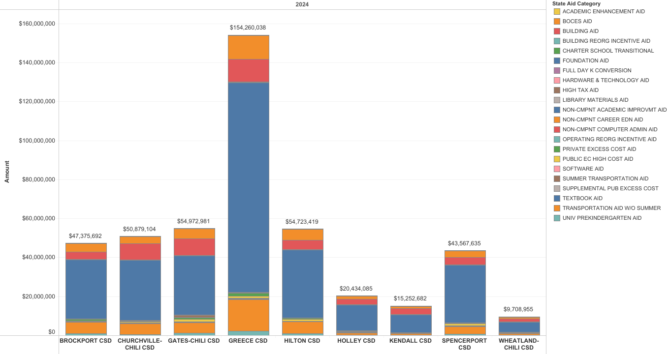
State Aid: Regional Comparison
Notes:
Note that building aid and public excess cost aid are high in our district as a percentage of state aid

Slide 42
State Aid: GC Historical Profile

Slide 43
Budgeting for Local Property Taxes

Slide 44
The Property Tax Cap
The property tax cap was signed into law on June 24, 2011 (see Chapter 97 of the NYS Laws of 2011).
Key Components of the Tax Cap
What is the property tax cap?
The tax cap law establishes a limit on the annual growth of property taxes levied by local governments and school districts to two percent or the rate of inflation, whichever is less.
Who is subject to the tax cap?
The cap applies to all independent school districts outside of the Big Five Cities (i.e., dependent school districts) and to all local governments including counties, cities, towns, villages and special districts (except those special districts noted below). The cap does not apply to New York City.

Slide 45
The Property Tax Cap (cont’d)
Key Components of the Tax Cap
Are there exceptions to the tax cap?
There are limited, narrow exclusions to the cap, including certain costs of significant judgments arising out of tort actions, changes in capital expenses, changes in Payment in Lieu of Taxes (PILOTS), and unusually large year-to-year increases in pension contribution rates.
Is there an override mechanism to the tax cap?
The tax levy cannot exceed the cap unless 60 percent of voters (for school districts) or 60 percent of the total voting power of the governing body (for local governments) approve such an increase.

Slide 46
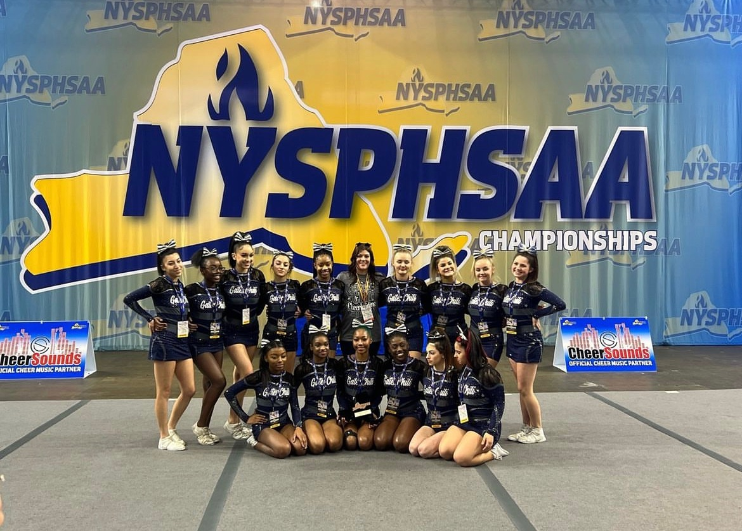
Current Property Tax
Local Property Taxes:
47.2% of all revenues
2022-23 Property Tax:
$58,213,114
Notes:
Local property taxes are the districts largest source of revenue at a little under 50 percent.
22-23 Property Tax = 51,213,114
22-23 STAR= 7,000,000
Total = 58,213,114

Slide 47
Our Critical Components
CPI-U: 2023 CPI-U = 4.12%
Tax base growth factor: 1.0068 (0.68%)
PILOTS decrease
From $2,624,782 to $1,468,802
Difference $(1,155,980)
ERS Rate over 2% of prior year
$14,096
2023-2024 13.1%
2024-2025 15.2%
Notes:
OSC announced employer contribution rates for the New York State and Local Retirement System (NYSLRS) for State Fiscal Year (SFY) 2024-25. Employers’ average contribution rates will increase from 13.1% to 15.2% of payroll for the Employees’ Retirement System (ERS). For additional information, please visit OSC’s webpage.
Proposed Other Pmts in Lieu of Taxes 2023-24 = $2,624,782
24-25 Proposed Other Pmts in Lieu of Taxes = $1,468,802

Slide 48
Breaking Budget News
Budgeting for Payments in Lieu of Taxes
(PILOTs)

Slide 49
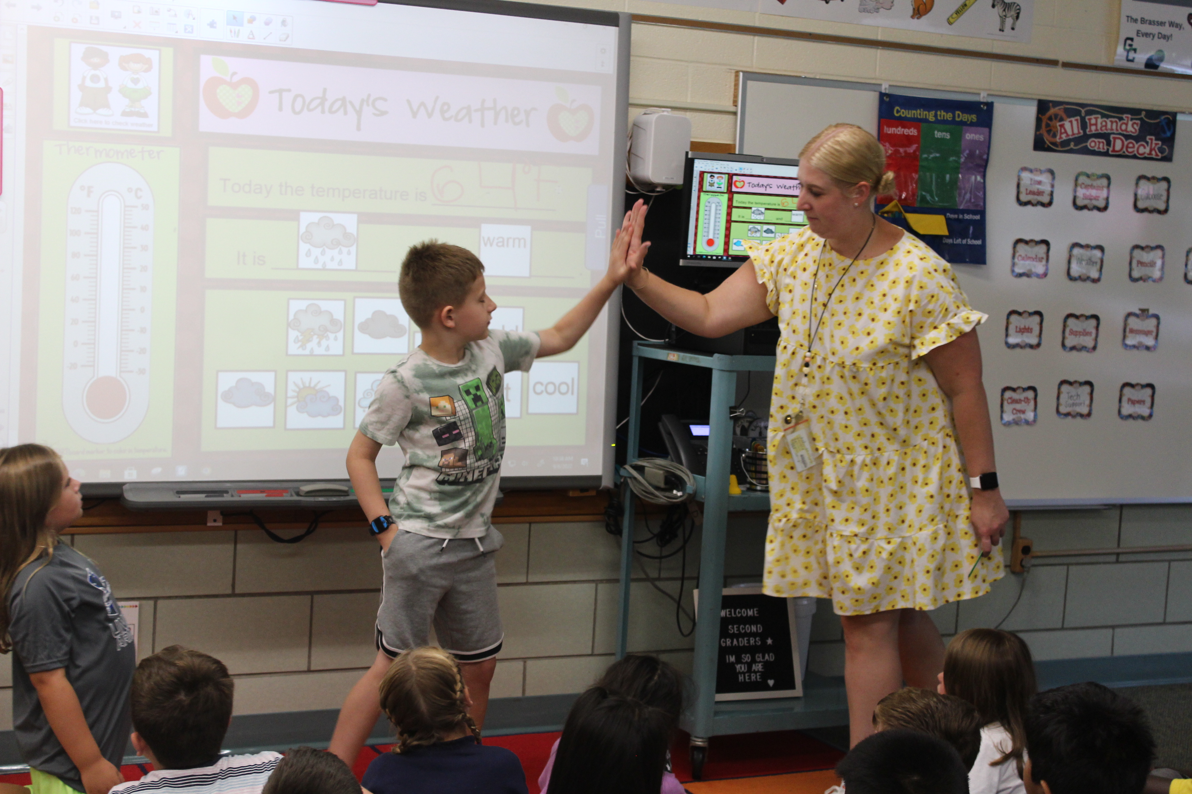
PILOTs
Gates:
CLA WNY LLC
Gallina Development Corp.
2013 VC LLC
Rotork Controls
Mastin of Rochester
Rochester Tech Park
2023 PILOTS: $2,624,782
2024 PILOTS: $1,468,802
Chili:
Wegmans
Pontarelli
39 Jetview Drive
44 Jetview Drive
200 Aviation Avenue
300 Trade Court Holdings
Howitt-Paul Road LLC
Notes:
44 Jetview: Trucking – Motor Freight
200 Aviation: Plastics Supplier
Howitt Paul Road: Townhouses
CLA: Real Estate Services
Gallina: Commercial Real Estate
2013 VC: Attorney
Boulder Point: Land Subdividers, Developers
Tech Park: Industry, Research, Mfg.

Slide 50
Breaking Budget News
There are two expiring Payments in Lieu of Taxes (PILOT) agreements within the Town of Chili:
Wegmans
Pontarelli
This means that we will no longer receive these payments through the PILOT agreement.
Notes:
PILOT for the following Completed: approx.: $1.5M reduction in PILOTs
Wegmans: 249 Fisher
Wegmans: 100
Wegman Market St
Wegmans: 300-350
Wegman Market St
Wegmans: 500 Wegman Market St
Wegmans: 400 Wegman Market St
Wegmans: 200 Wegman Market St
Wegmans: 360 Wegman Market St
Wegmans: Rec Center
Wegman Market St Wegmans:
600 Wegman Market St
Wegmans: 370 Wegman Market St (Cheese Building)
Wegmans: 360 Wegman Market St (Waste Water)
Pontarelli Associates, LLC
Pontarelli Associates, LLC
Pontarelli Associates, LLC
Current Tax Cap is anywhere from 1.75% to 2.5%, unless there is a substantial change in estimations.
Consumer Price Index for All Urban Consumers (CPI-U)
What will CPI be in 2024?
On the basis of these inflation forecasts, average consumer price inflation should be 3.2% in 2024, compared to 4.06% in 2023 and 9.59% in 2022.

Slide 51
Breaking Budget News
Therefore, the tax cap calculation increases the total levy by the decrease in PILOT payments to be received.
But this doesn’t mean your taxes go up by this difference!
This additional taxation is distributed across the increased assessments that are coming back onto to the tax rolls.
Notes:
PILOT for the following Completed: approx.: $1.5M reduction in PILOTs
Wegmans: 249 Fisher
Wegmans: 100
Wegman Market St
Wegmans: 300-350
Wegman Market St
Wegmans: 500 Wegman Market St
Wegmans: 400 Wegman Market St
Wegmans: 200 Wegman Market St
Wegmans: 360 Wegman Market St
Wegmans: Rec Center
Wegman Market St Wegmans:
600 Wegman Market St
Wegmans: 370 Wegman Market St (Cheese Building)
Wegmans: 360 Wegman Market St (Waste Water)
Pontarelli Associates, LLC
Pontarelli Associates, LLC
Pontarelli Associates, LLC
Current Tax Cap is anywhere from 1.75% to 2.5%, unless there is a substantial change in estimations.
Consumer Price Index for All Urban Consumers (CPI-U)
What will CPI be in 2024?
On the basis of these inflation forecasts, average consumer price inflation should be 3.2% in 2024, compared to 4.06% in 2023 and 9.59% in 2022.

Slide 52
Estimated Property Tax
2024-25 Estimate: $62,990,603
Increase of 4.96%, or $2,975,983
Increase w/o PILOTS: 3.04%
Estimated True Value Tax Rate:
$24.99
Based on 2023 EQ Rates and Assessments
Notes:
Last year, blended: $24.41
Use the tax rate calculation excel for the year projecting for
C:\Users\amlamb\Gates Chili CSD\Business Office - Budgeting - Budgeting\Budgeting for 2023-2024\Tax Rate
Last two years of increase have been 2.38%, and 2.1% respectively.
21-22 = 56,958,890
22-23 = 58,213,114
23-24 = 59,954,918
24-25 = 62,930,900,

Slide 53
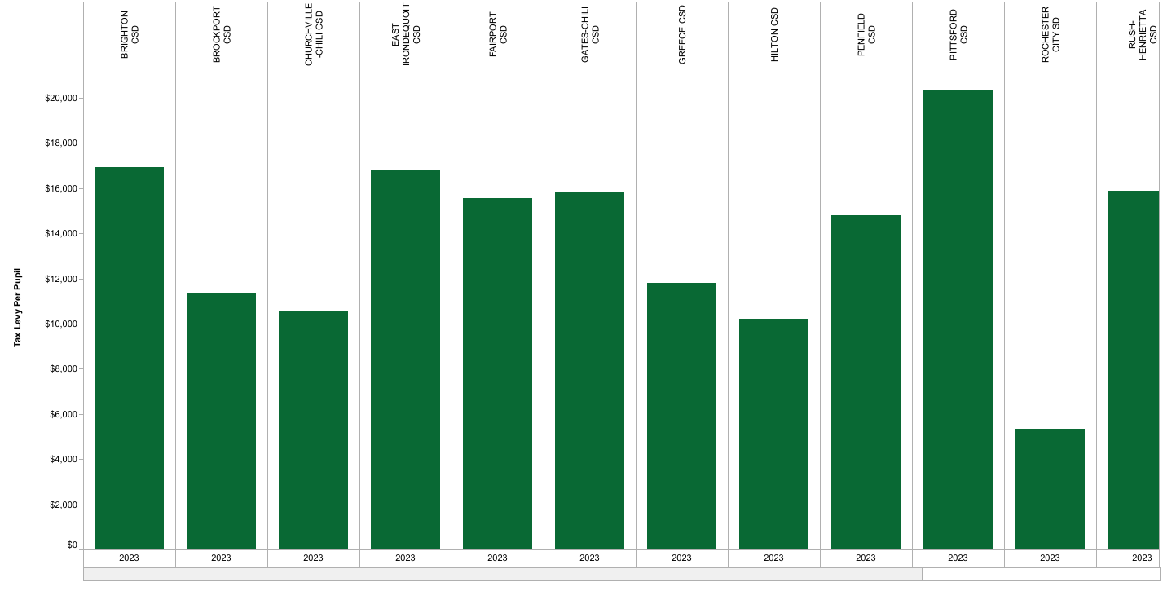
2022 Tax Levy – Per Student
Notes:
2021 Tax Levy = $44,821,084/3,579 students = $15,597 per student

Slide 54
Tax Levy as a % of Revenue
Key Takeaway:
Gates Chili has a greater reliance on local tax revenue compared to our westside peers. This is a result of less favorable state aid ratios.
Think CWR (Combined Wealth Ratio)!

Slide 55
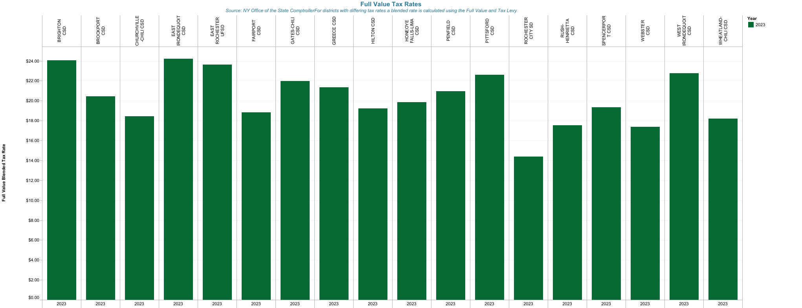
2022 Tax Rate Comparison – Monroe County
Notes:
2022 True Value Tax Rate was $24.14 for both towns.
Notes:
2021/2022 rates: 2022/2023 rates:
Town of Chili = $24.05 Town of Chili = $24.14
Town of Gates = $24.05 Town of Gates = $24.14

Slide 56
Budgeting for Monroe County Sales Tax

Slide 57
Local MC Sales Tax
3.07% of all revenue
Monroe County distributes
2023-24 (Budget): $4,000,000
2024-25 (Estimated): $4,066,069
Notes:
Local sales tax represents a little over three percent of the proposed 21-22 revenue budget, down from a little over four percent in 2019, 2020.
Hoping to increase again after pandemic slowed everything down

Slide 58
Budgeting for Other Revenues

Slide 59
Other Revenue Areas
Less than 2% of budget:
Interest Earnings Slight increase due to rate increase
Continuing Education No Change
Day School Tuition $5K increase
Health Services No Change
Medicaid No Change
Minor Sales No Change
Student Fees/Charges No Change
Tuition No Change
Notes:
Interest Earnings
Continuing Education
Day School Tuition
Health Services
Medicaid
Minor Sales
student fees

Slide 60
Budgeting for Fund Balance and Reserve Use

Slide 61
Appropriated Fund Balance
Funds carried over from the prior year to balance current year budgets
Probably will not need due to Foundation Aid increase
2023-24: $1,100,000
2024-25: TBD
Notes:
Get numbers from the revenue development worksheet A5997.001

Slide 62
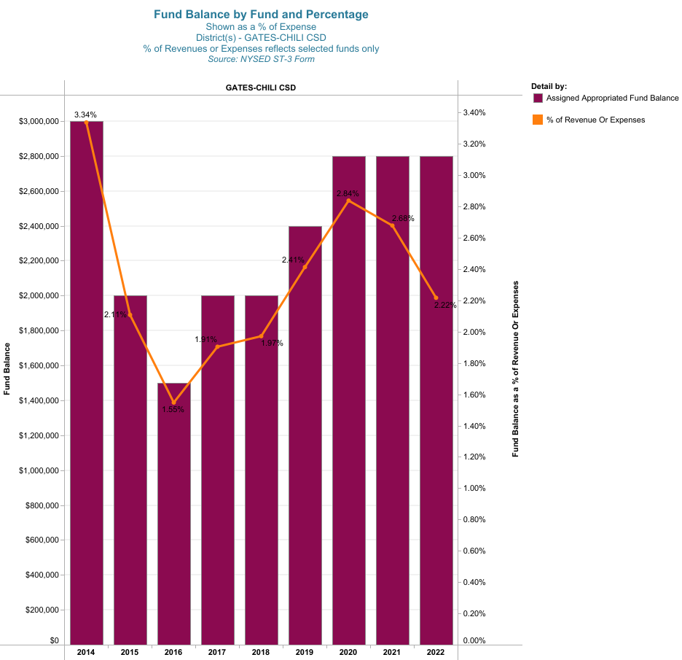
Fund Balance as a % of Expenses
Notes:
A healthy and responsible fund balance is in the 2-4% range

Slide 63
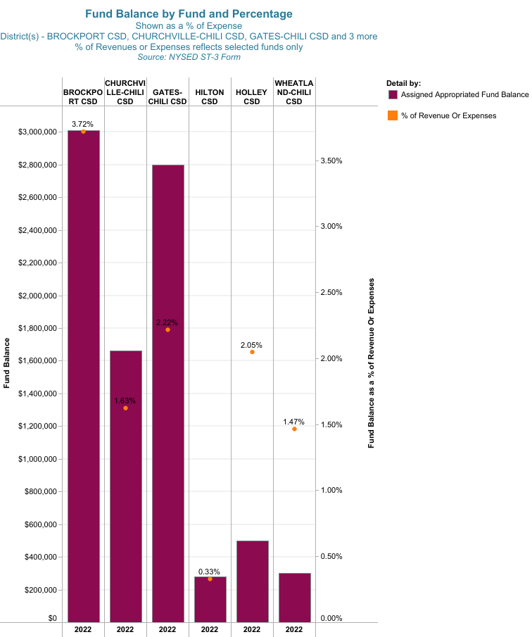
Fund Balance as a % of Expense
Notes:
Our fund balance is average.

Slide 64
Comparison: Revenues to Expenditures
Revenue
Expense
In reality, we experienced a prudent $4.6M surplus
Notes:
FYE6302022 deficit of ($12,385,040) due to the $15M Capital Reserve Transfer to H Capital Fund. Otherwise, a surplus of $2,614,960 would be recognized. Plus the roof project of $2M. Therefore surplus of $4,614,960

Slide 65
Overall…Right Correcting
NOTE: Actual surplus of $4.6M in 2022
Notes:
FYE6302022 deficit of ($12,385,040) due to the $15M Capital Reserve Transfer to H Capital Fund. Otherwise, a surplus of $2,614,960 would be recognized.

Slide 66
Reserves
Handout: Intended Use of Reserves
Governed by two sets of regulations
General Municipal Law (GML)
Education Law (Ed Law)
All very restrictive - used for specific purposes
Not “slush funds”
BOE Adopted Reserve Plan
www.gateschili.org/page/18376
Notes:
Financial Reserve Plan - May 2023.pdf

Slide 67
Worker’s Compensation Reserve (GML Article 2 §6-j)
Established by Board of Education resolution
Funded by budgetary appropriations and other sums as may be legally appropriated (e.g., surplus monies).
Voter approval is not needed to expend funds
Utilized to pay expenses from pay for Workers' Compensation and benefits, related medical/hospital expenses, and self-insurance administrative
Excess funds may be transferred to other reserves authorized by General Municipal Law and Education Law sixty days before the end of the fiscal year
Balance: $1,201,203
Notes:
GL ACCT 814.00

Slide 68
Unemployment Insurance Reserve (GML Article 2 §6-m)
Established by Board of Education resolution
Funded by budgetary appropriations, amounts from any other fund authorized by this chapter by resolution subject to referendum, or other sums that may be legally appropriated
Voter approval is not needed to expend funds
Utilized to pay unemployment claims
Excess funds may be transferred to other reserves authorized by General Municipal Law and Education Law 60 days before the end of the fiscal year
The district is obligated to pay 100% of all unemployment claims granted by the NYS Department of Labor
Balance: $714,720
Notes:
GL ACCT 815.00

Slide 69
Retirement (ERS) Contributions Reserve (GML Article 2 § 6-r)
Established by Board of Education
Funded by budgetary appropriations, revenues not required by law to be paid into other funds or accounts, transfers from other reserve funds as permitted by law, and such other funds as the board may legally appropriate
Voter approval is not needed to expend funds
A portion of the funds may be transferred to another reserve fund established pursuant to Education Law § 3651 following a public hearing conducted in the manner set forth by in law
Used to offset employer costs associated with the NYSERS pension system
Balance: $8,431,263
Notes:
GL ACCT 827.00

Slide 70
Retirement (TRS) Contributions Reserve (GML Article 2 § 6-r)
Established by Board of Education
Funded by budgetary appropriations, revenues not required by law to be paid into other funds or accounts, transfers from other reserve funds as permitted by law, and such other funds as the board may legally appropriate
Voter approval is not needed to expend funds
A portion of the funds may be transferred to another reserve fund established pursuant to Education Law § 3651 following a public hearing conducted in the manner set forth by in law
Used to offset employer costs associated with the NYSTRS pension system
Balance: $2,747,295
Notes:
GL ACCT 828.00

Slide 71
Insurance Reserve (GML Section 6-n)
Established by Board of Education resolution
Voter approval is not needed to expend funds
To fund certain uninsured losses, claims, actions or judgments for which the local government is authorized or required to purchase or maintain insurance, with exceptions.
May also be used to pay for expert or professional services in connection with the investigation, adjustment or settlement of claims, actions or judgments.
Monies remaining in the fund in excess sufficient to pay all liabilities incurred or accrued may be transferred to another reserve fund established under Education Law Section 3651.
Balance: $1,251,504
Notes:
GL ACCT 864.00

Slide 72
Tax Certiorari Reserve [EDN Article 74 §3651 (1-a)]
Established by Board of Education resolution
Voter approval is not needed to expend funds
Utilized to pay judgments and claims arising out of tax certiorari proceedings
Established in the amount which might be deemed reasonably necessary to pay judgments and claims
Monies not used and/or are not reasonably required to pay judgments or claims are to be returned to the general fund on or before the first day of the fourth fiscal year following deposit into such fund
Such monies shall be deemed reasonably required to pay any such judgment or claim if the proceeding or claim has not been finally determined, or otherwise terminated or disposed of after the exhaustion of all appeals
Balance: $2,952,006
Notes:
GL ACCT 864.00

Slide 73
Employee Benefits Accrued Liability Reserve (GML Article 2 § 6-p)
Established by Board of Education
Funded by budgetary appropriations, transfers from other reserve funds as permitted by law, and other funds as the school board may legally appropriate
Voter approval is not needed to expend funds
Utilized to pay for accrued and accumulated but unused sick leave, personal leave, holiday leave, vacation time, and other benefits earned by employees and payable upon termination
Upon determination that this fund is no longer needed the fund may be discontinued and funds may be transferred to another reserve fund as permitted by law
Funds cannot be used to pay lump sum “retirement awards” calculated as a percent of an employee’s final salary and paid upon retirement under a collective bargaining agreement
Balance: $1,191,309
Notes:
GL ACCT 867.00

Slide 74
Capital Reserve 2021: Construction [EDN Article 74 § 3651 (1)]
Established by voter approval
States the specific purpose of the fund, the amount, the term of fund, and sources where fund is obtained e.g. budgetary appropriations, unappropriated fund balance, and New York State aid
Utilized to pay for any object or purpose for which a school district may issue bonds pursuant to Finance Law
Expended only with voter approval and for the purpose for which the fund was established
Transferred to other funds only by voter approval
May be liquidated by approval of voters if determined fund is no longer needed for the original purpose. Proceeds must be applied first to outstanding bond indebtedness than to tax levy
Balance: $5,044,206
(max $10,000,000)
Notes:
GL ACCT 878.20

Slide 75
Capital Reserve 2023: Construction [EDN Article 74 § 3651 (1)]
Established by voter approval
States the specific purpose of the fund, the amount, the term of fund, and sources where fund is obtained e.g. budgetary appropriations, unappropriated fund balance, and New York State aid
Utilized to pay for any object or purpose for which a school district may issue bonds pursuant to Finance Law
Expended only with voter approval and for the purpose for which the fund was established
Transferred to other funds only by voter approval
May be liquidated by approval of voters if determined fund is no longer needed for the original purpose. Proceeds must be applied first to outstanding bond indebtedness than to tax levy
Balance: $6,117,903
(max $15,000,000)
Notes:
GL ACCT 878.20

Slide 76
Capital Reserve: Technology [EDN Article 74 § 3651 (1)]
Established by voter approval
States the specific purpose of the fund, the amount, the term of fund, and sources where fund is obtained (e.g., budgetary appropriations, unappropriated fund balance and New York State aid)
Utilized to pay for any object or purpose for which a school district may issue bonds pursuant to Finance Law
Expended only with voter approval and for the purpose for which the fund was established
Transferred to other funds only by voter approval
May be liquidated by approval of voters if determined fund is no longer needed for the original purpose. Proceeds must be applied first to outstanding bond indebtedness than to tax levy
Balance: $603,610
(max $1,000,000)
Notes:
GL ACCT 878.TE

Slide 77
Capital Reserve: Vehicles [EDN Article 74 § 3651 (1)]
Established by voter approval
States the specific purpose of the fund, the amount, the term of fund, and sources where fund is obtained (e.g., budgetary appropriations, unappropriated fund balance and New York State aid)
Utilized to pay for any object or purpose for which a school district may issue bonds pursuant to Finance Law
Expended only with voter approval and for the purpose for which the fund was established
Transferred to other funds only by voter approval
May be liquidated by approval of voters if determined fund is no longer needed for the original purpose. Proceeds must be applied first to outstanding bond indebtedness than to tax levy
Balance: $301,805
(max $500,000)
Notes:
GL acct 878.VH

Slide 78
Capital Reserve: Building Security Infrastructure
[EDN Article 74 § 3651 (1)]
Established by voter approval
States the specific purpose of the fund, the amount, the term of fund, and sources where fund is obtained (e.g., budgetary appropriations, unappropriated fund balance, and New York State aid)
Utilized to pay for any object or purpose for which a school district may issue bonds pursuant to Finance Law
Expended only with voter approval and for the purpose for which the fund was established
Transferred to other funds only by voter approval
May be liquidated by approval of voters if determined fund is no longer needed for the original purpose. Proceeds must be applied first to outstanding bond indebtedness than to tax levy
Balance: $301,805
(max $4,000,000)
Notes:
GL acct 878.SI

Slide 79
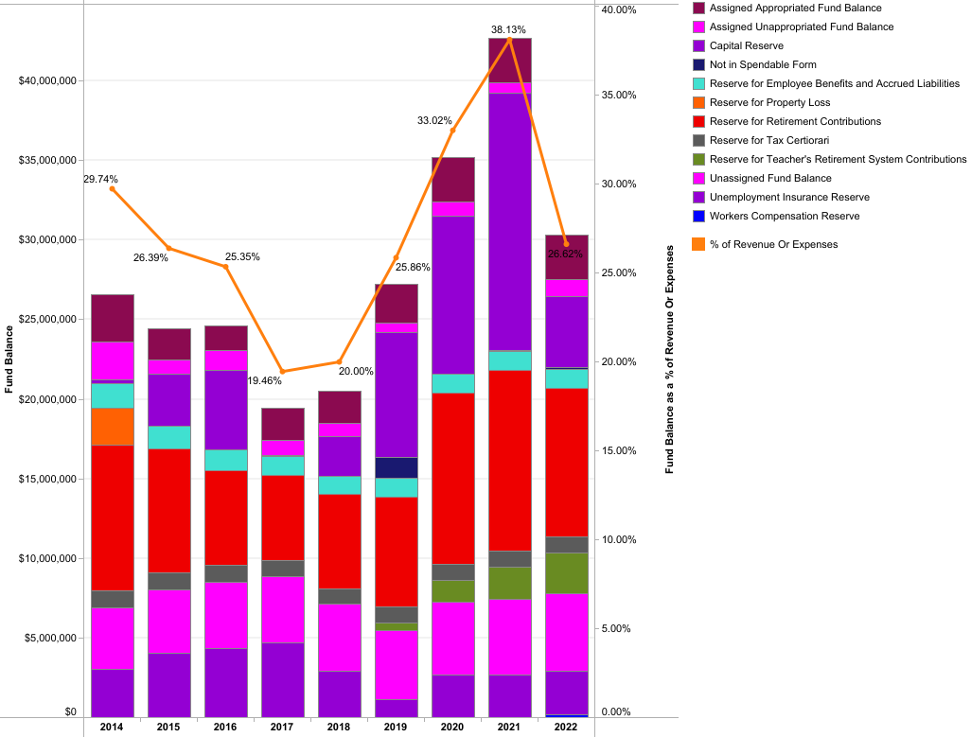
Reserves and Fund Balance Trending
Notes:
Capital Project savings led to the uptick in the percentage until 2022. This percentage went down post-$15M Capital Reserve transferred to Capital Fund for new $45.5M project at June 30, 2022.

Slide 80
Revenues: Summary Information

Slide 81
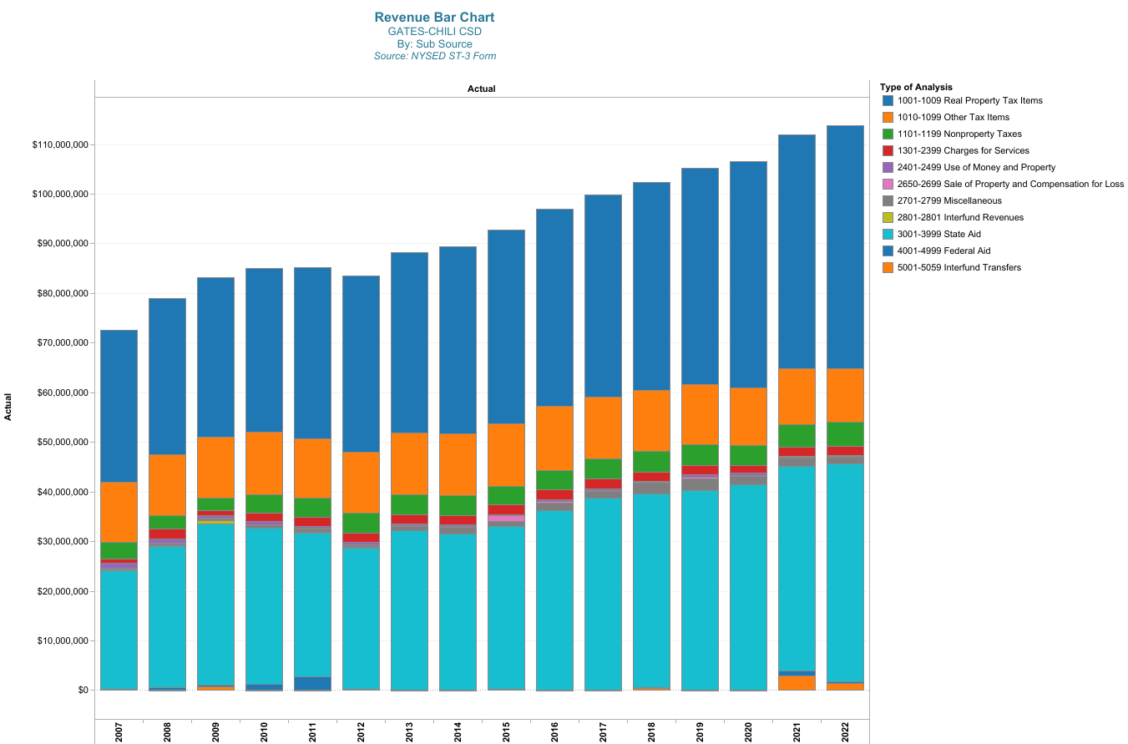
Overall Revenue Breakout
Notes:
The blue and orange include the tax levy and PILOTS
Notes:
Big orange is PILOTS
Green is sales tax

Slide 82
Prudent Revenue Predictions
Notes:
2020 is COVID

Slide 83
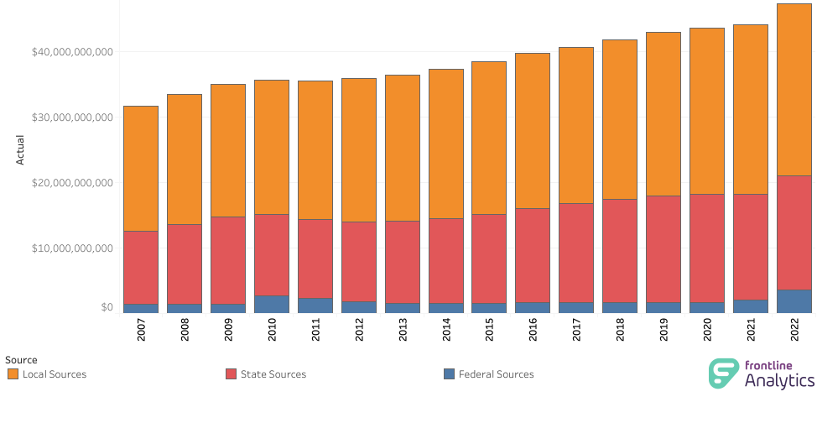
Statewide Breakdown of Revenues Sources

Slide 84
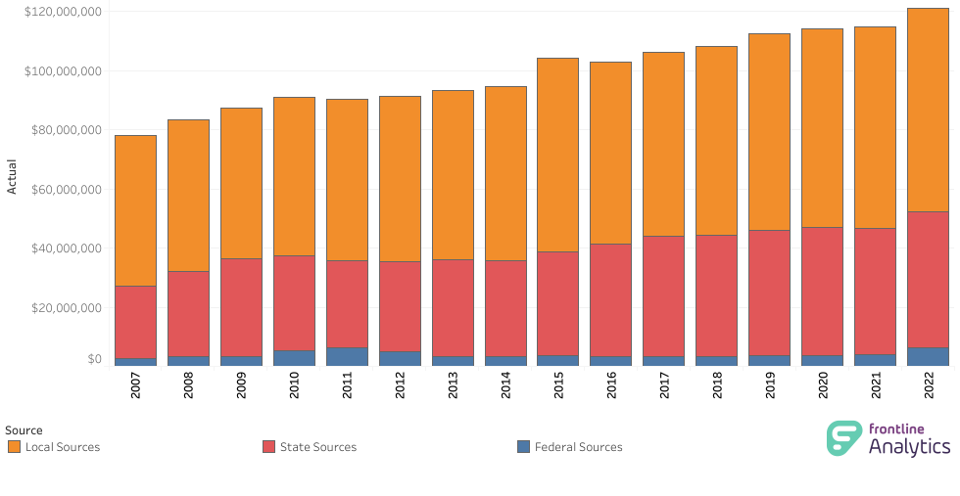
Gates Chili CSD Breakdown of Revenue Sources
Key Take away:
Consistent with statewide breakdown

Slide 85
Local Region Comparison
Key Take aways:
GC is more reliant on local sources of revenue than other regional districts (think CWR)
GC has a larger proportion of legally mandated cost drivers that other regional districts don’t
Yet, still consistent with the state
Notes:
Interfund Revenue from F Fund for CARES Act Funding

Slide 86
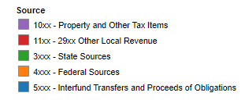
Per Student Revenue by Source
Notes:
Left: $/student per revenue source
Right: If you were to take every dollar, here is the split out per source that supports that dollar.
Interfund transfers are debt service transfers

Slide 87
Students with Disabilities Spending
Notes:
A2250 function over all general fund functions as a percentage.
A2250 function expenses divided by SWD enrollment as a dollar amount per student.

Slide 88
2024-25: Revenue Budget Breakdown
School Property Taxes 47¢
NY State Aid 42¢
Monroe County Sales Tax 3¢
Fund Balance and Reserves 4¢
Other Revenues 4¢
Interest earnings, payments in-lieu of taxes, Medicaid, admissions, fees, tuition

Slide 89
Local Economic Impact

Slide 90
2020-2021 Local Economic Impact
Spending in Gates Chili CSD contributes to local, regional, and statewide economic well-being. The table below estimates that contribution using the IMPLAN economic modeling system.
Local Impact
 | Direct* | Spillover | Total
Employment (FTE) | 798 | 774 | 1,571
Income | $44.7M | $41.6M | $86.4M
Income Tax | $2.2M | $2M | $4.2M
Sales Tax | $1.1M | $1.1M | $2.2M
Notes:
https://www.asbonewyork.org/mpage/economic-impact-update
The Gates-Chili school district spends $108M in order to educate students in the district. This spending also contributes to local, regional, and statewide economic well-being. The following tables estimate that contribution.
The Gates-Chili school district directly employs about 798 people. The district's purchase of goods and services as well as employee personal spending is responsible for about 774 additional spillover jobs in the Finger Lakes region. The school district is responsible for a total of about 1,571 jobs. These jobs generate $86.4 million in income. $44.7 million is directly connected to Gates-Chili employees. Another $41.6 million is generated by spillover spending that generate additional jobs. This income generates an estimated $4.2 million in state income tax in total and $2.2 million in sales tax.
This analysis shows the economic impact of public education goes far beyond the people directly employed by school districts. School district spending in 2020-21 resulted in nearly 700,000 jobs around the state, about 377,000 jobs directly funded by schools and just under 300,000 jobs that result from spending of school districts and school employees. As voters go to the polls to decide on school budgets, they should consider both the long-term benefits of funding public education and the immediate economic impact of school district spending.

Slide 91
Budget Proposition and BOE Elections

Slide 92
Vote Propositions
Expenditure Budget
Bus Purchase

Slide 93
Board of Education Election
Four (4) seats available:
Three (3) seats with terms from July 1, 2024 to June 30, 2027
One (1) seat with a term from May 22, 2024, to June 30, 2026
Petitions are due to the
District Clerk by
Friday, April 22 at 4 p.m.

Slide 94
Budget Calendar and Timeline
February to March 2024 | Buildings and Departments' staffing budgets will be reviewed and finalized by the Executive
March 1 | Tax Levy limit calculation due
March 7 | Budget Ambassadors Workshop - Expenditures
March 14 | Budget Ambassadors Workshop - Revenues
March 18 | Budget presentation to Finance Committee
March 21 | Budget Ambassadors Workshop (if necessary)
March 26 | Budget and Revenue updates and Tax Rate projections were presented to the Board of Education. Approval of School Bus Proposition
April 16 | Budget Adoption by the Board of Education
May 7 | Public Budget Hearing and Meet the Candidates Night
May 21 | Annual Budget Vote and BOE Election - Spartan Field House 6:30 a.m. to 8:30 p.m.

Slide 95
Questions?

Slide 96
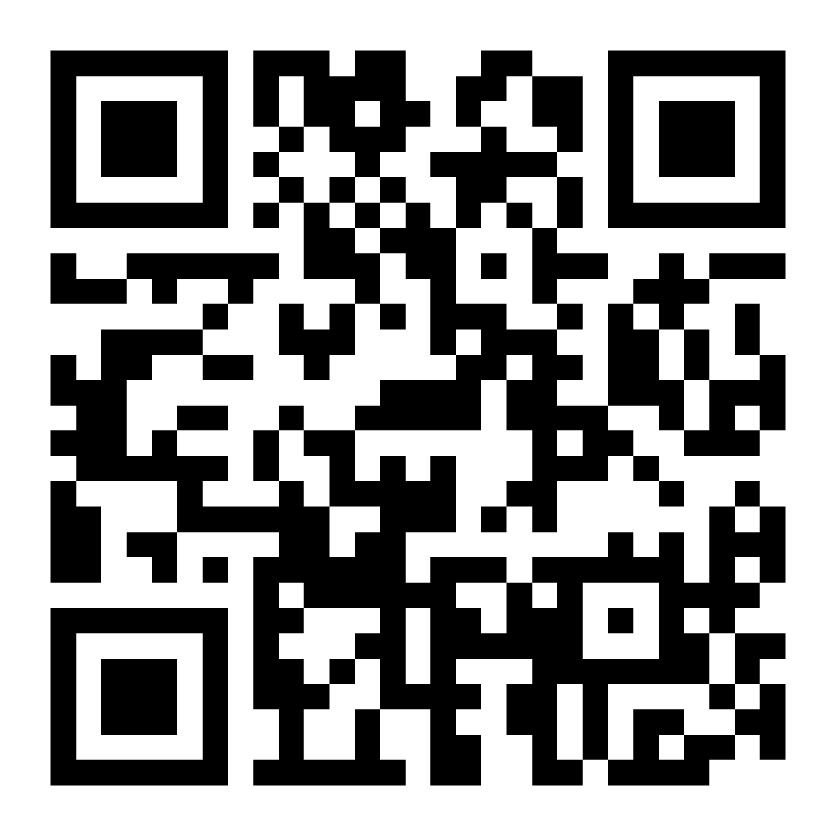
Budget Ambassador Survey
Scan the QR code with your phone’s camera or go to the URL below to complete a short survey about your experience as a Gates Chili Budget Ambassador by Wednesday, March 20 at 5 p.m.
gateschili.org/BudgetAmbassadorSurvey

Slide 97
Thank You!

Slide 98
